Slide 1
Introduction to Bioinformatics Day 1: Introduction to Bioinformatics and Biological Resources 12th January 2026

Slide 2

Instructors
Dr. Muhammad Waqas Ali (Oxford, OBU, UK)

Slide 3
Course Schedule and Content Overview
Day | Content overview
Day 1 | Introduction to Bioinformatics and Biological Resources
Day 2 | Sequence Alignment and Phylogenetics
Day 3 | Genomics, Metagenomics and Transcriptomics
Day 4 | Proteomics and Structural Bioinformatics
Day 5 | Exam
Course Timing and Duration
Training Sessions: TotaI of 6 hours,
Morning (9:00 AM -12:00 PM)
Afternoon (2:00 PM - 5:00 PM)
Breaks: 12.:00 PM to 2:00 PM (Prayer and Lunch)
Operational Days: 5 consecutive days, (12th - 16th of Jan. 2026)
Content
Composition: 30% theory + 70% hands on
Targeted Students: Life Sciences + Computer Sciences

Slide 4
Learning Objectives
Bioinformatics Basics:
Define bioinformatics and its key applications.
Understand molecular biology fundamentals relevant to bioinformatics.
Database Utilization:
Navigate and query biological databases like GenBank, PDB, and KEGG using web tools and programming.
Sequence Alignment
Perform pairwise and multiple sequence alignments.
Phylogenetics:
Construct and interpret phylogenetic trees.
Genomics and Metagenomics:
Analyse genomic and metagenomic data
Transcriptomics:
Conduct RNA-seq analysis and interpret gene expression data.
Proteomics and Structural Bioinformatics:
Access and Use Proteomics resources, Predict protein structures

Slide 5
Learning Outcomes
Knowledge Appllication:
Explain bioinformatics concepts and molecular biology processes.
Database Skills:
Efficiently query and utilize biological databases.
Alignment Proficiency:
Conduct and interpret sequence alignments.
Phylogenetic Analysis:
Build and analyse phylogenetic trees.
Genomic and Metagenomic Insights:
Analyse and interpret genomic and metagenomic data.
Transcriptomic Skills:
Perform and interpret RNA-seq data analyses.
Proteomics and Structural Analysis:
Predict, visualize, and analyse protein structures and interactions.

Slide 6
Day 1: Introduction to Bioinformatics and Biological Resources Morning Session

Slide 7
Outline Day 1
Morning (9-12 pm):
Introduction to Bioinformatics:
Overview of bioinformatics:
Basics of molecular biology relevant to bioinformatics
Genomics, Metagenomics, Transcriptomics, Proteomics
Practical Session:
Exploring the central dogma (using R).
Afternoon (2-5 pm):
Biological Resources:
Types of biological databases/resources: Sequence, structure, functional.
Overview of genomic, transcriptomic, and proteomic databases/resources.
Practical Session:
Primary Option: Query databases like GenBank, PDB, and KEGG (web-based).
Alternative: Access and query these databases using Ensembl.

Slide 8
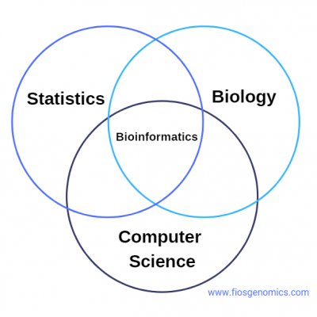
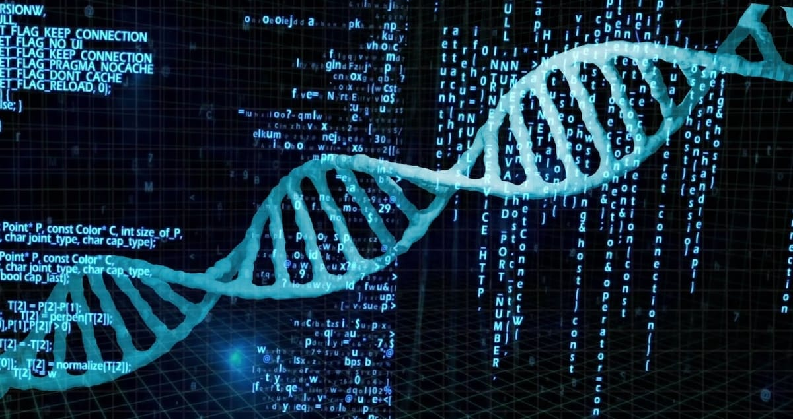
What is Bioinformatics?
Interdisciplinary field that combines life sciences, computer sciences, and statistics to analyse and interpret biological data.
Source: https://www.fiosgenomics.com/what-is-bioinformatics-overview-and-examples/

Slide 9
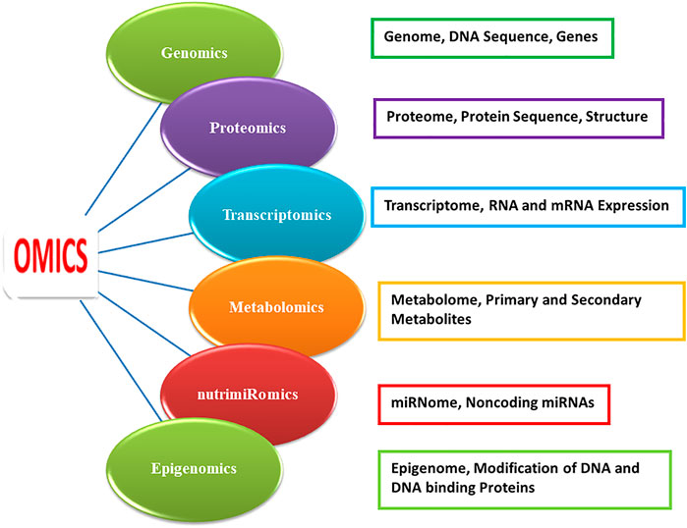
Key Omics Disciplines in Bioinformatics

Slide 10
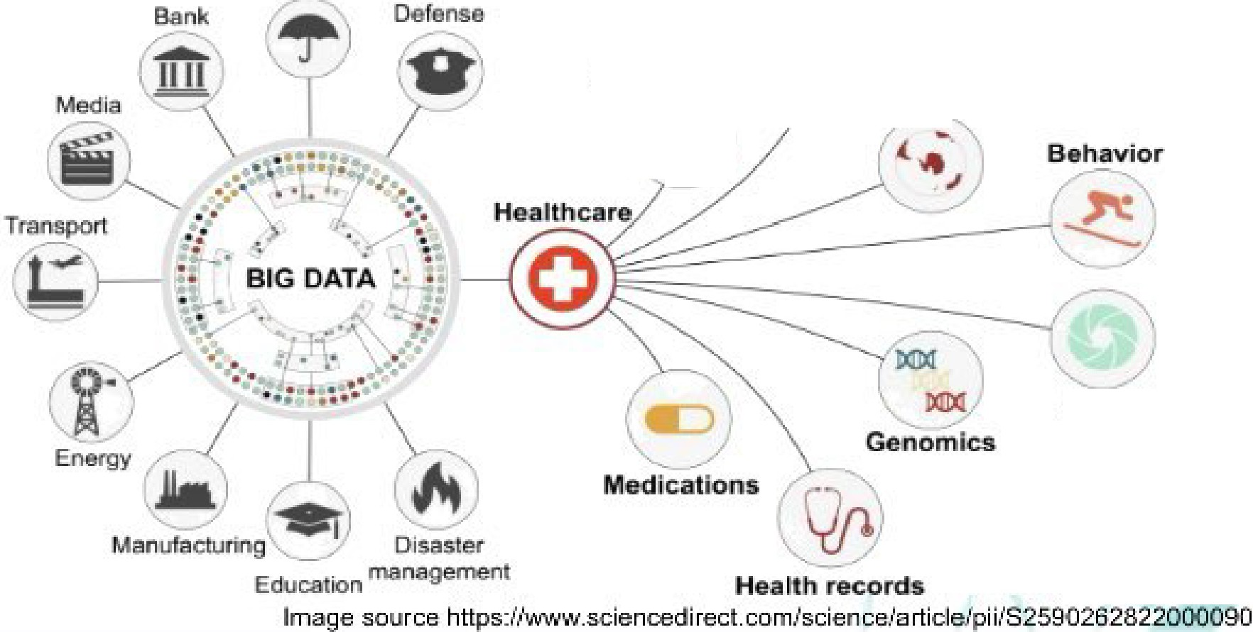
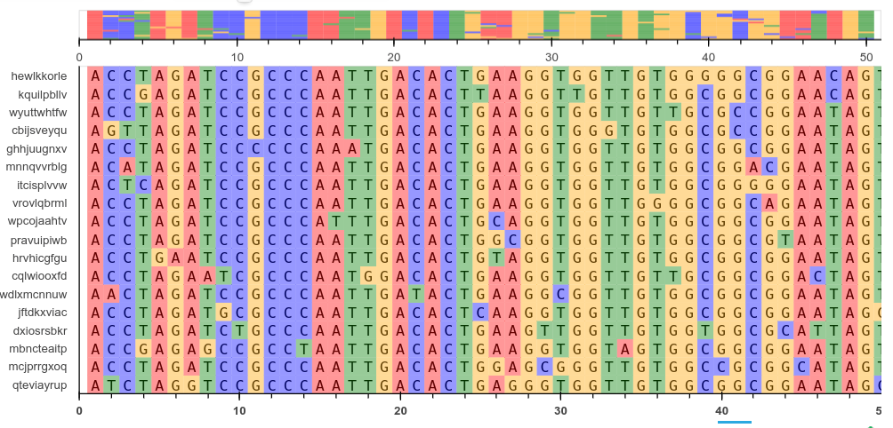
Why do we need Bioinformatics ?
1. Key Complexity Factors
Volume: Massive datasets from high-throughput technologies
Variety: Different data types (Genomics, proteomics, transcriptomics, and more) and various formats (sequences., structures, networks) require specialized analysis
Velocity: Rapid data generation and updates
Variability: Inherent noise and inconsistencies in biological systems

Slide 11
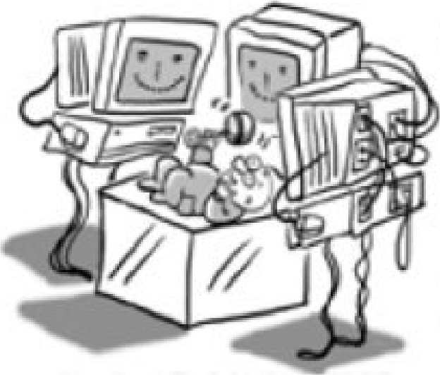
Why do we need Bioinformatics?
Challenges
Integration: Merging diverse data sources.
interpretation: Extracting meaningful insights.
Scalability: Effidently handling large datasets.
The Role of Bioinformatics
Solution: Computational tools and interdisciplinary approaches to manage and interpret complex biological data.

Slide 12
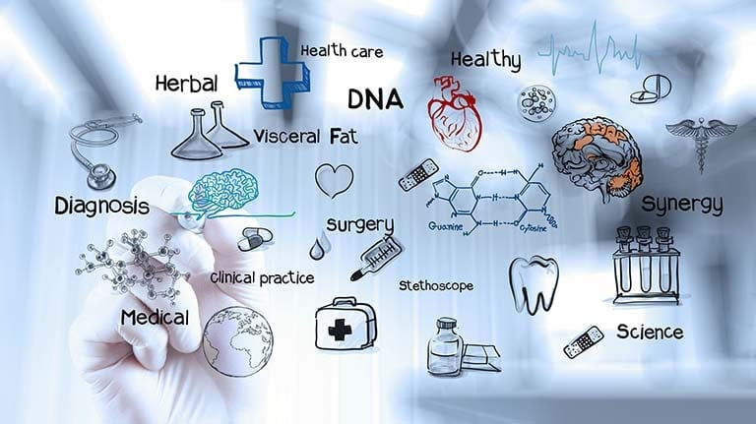
Applications of Bioinformatics
Biotechnology & Biofuels:
Enhancing enzyme production, Genetically Modified Organisms., and developing efficient biofuels.
Drug Discovery & Preventive Medicine: Identifying drug targets, designing drug1s, and predicting disease risks.
Gene Therapy & Stem Cell Therapy:
Optimizing gene edit1ing and improving stem cell treatments.

Slide 13
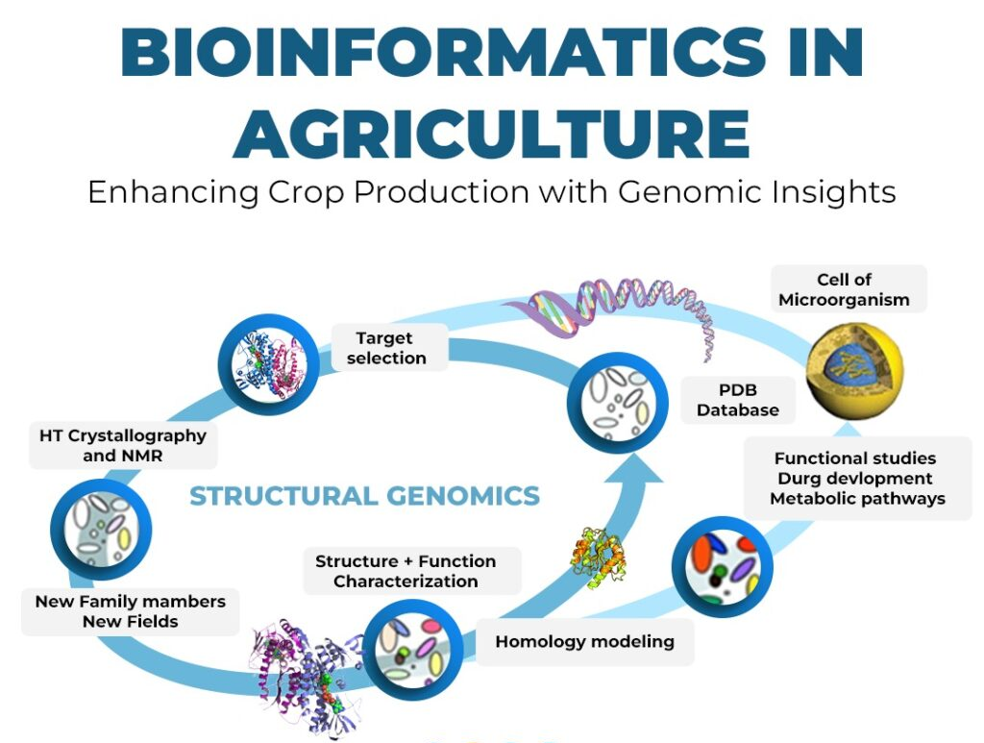
Applications of Bioinformatics
Environmental & Climate Applications: Bioremediation, studying climate impacts, and engineering resistant crops.
Agriculture & Nutrition:
Improving crop yield, resistance, and nutritional quality.
Microbial & Evolutionary Studies:
Analysing microbial genomes and tracing species evolution.
Forensic & Veterinary Sciences:
DNA analysis for identity verification, criminal investigations, and improving animal health.
Antibiotic Resistance & Insect Resistance: Studying resistance mechanisms and engineering crops against pests.

Slide 14
Bioinformatics in Saudi Arabia

Slide 15
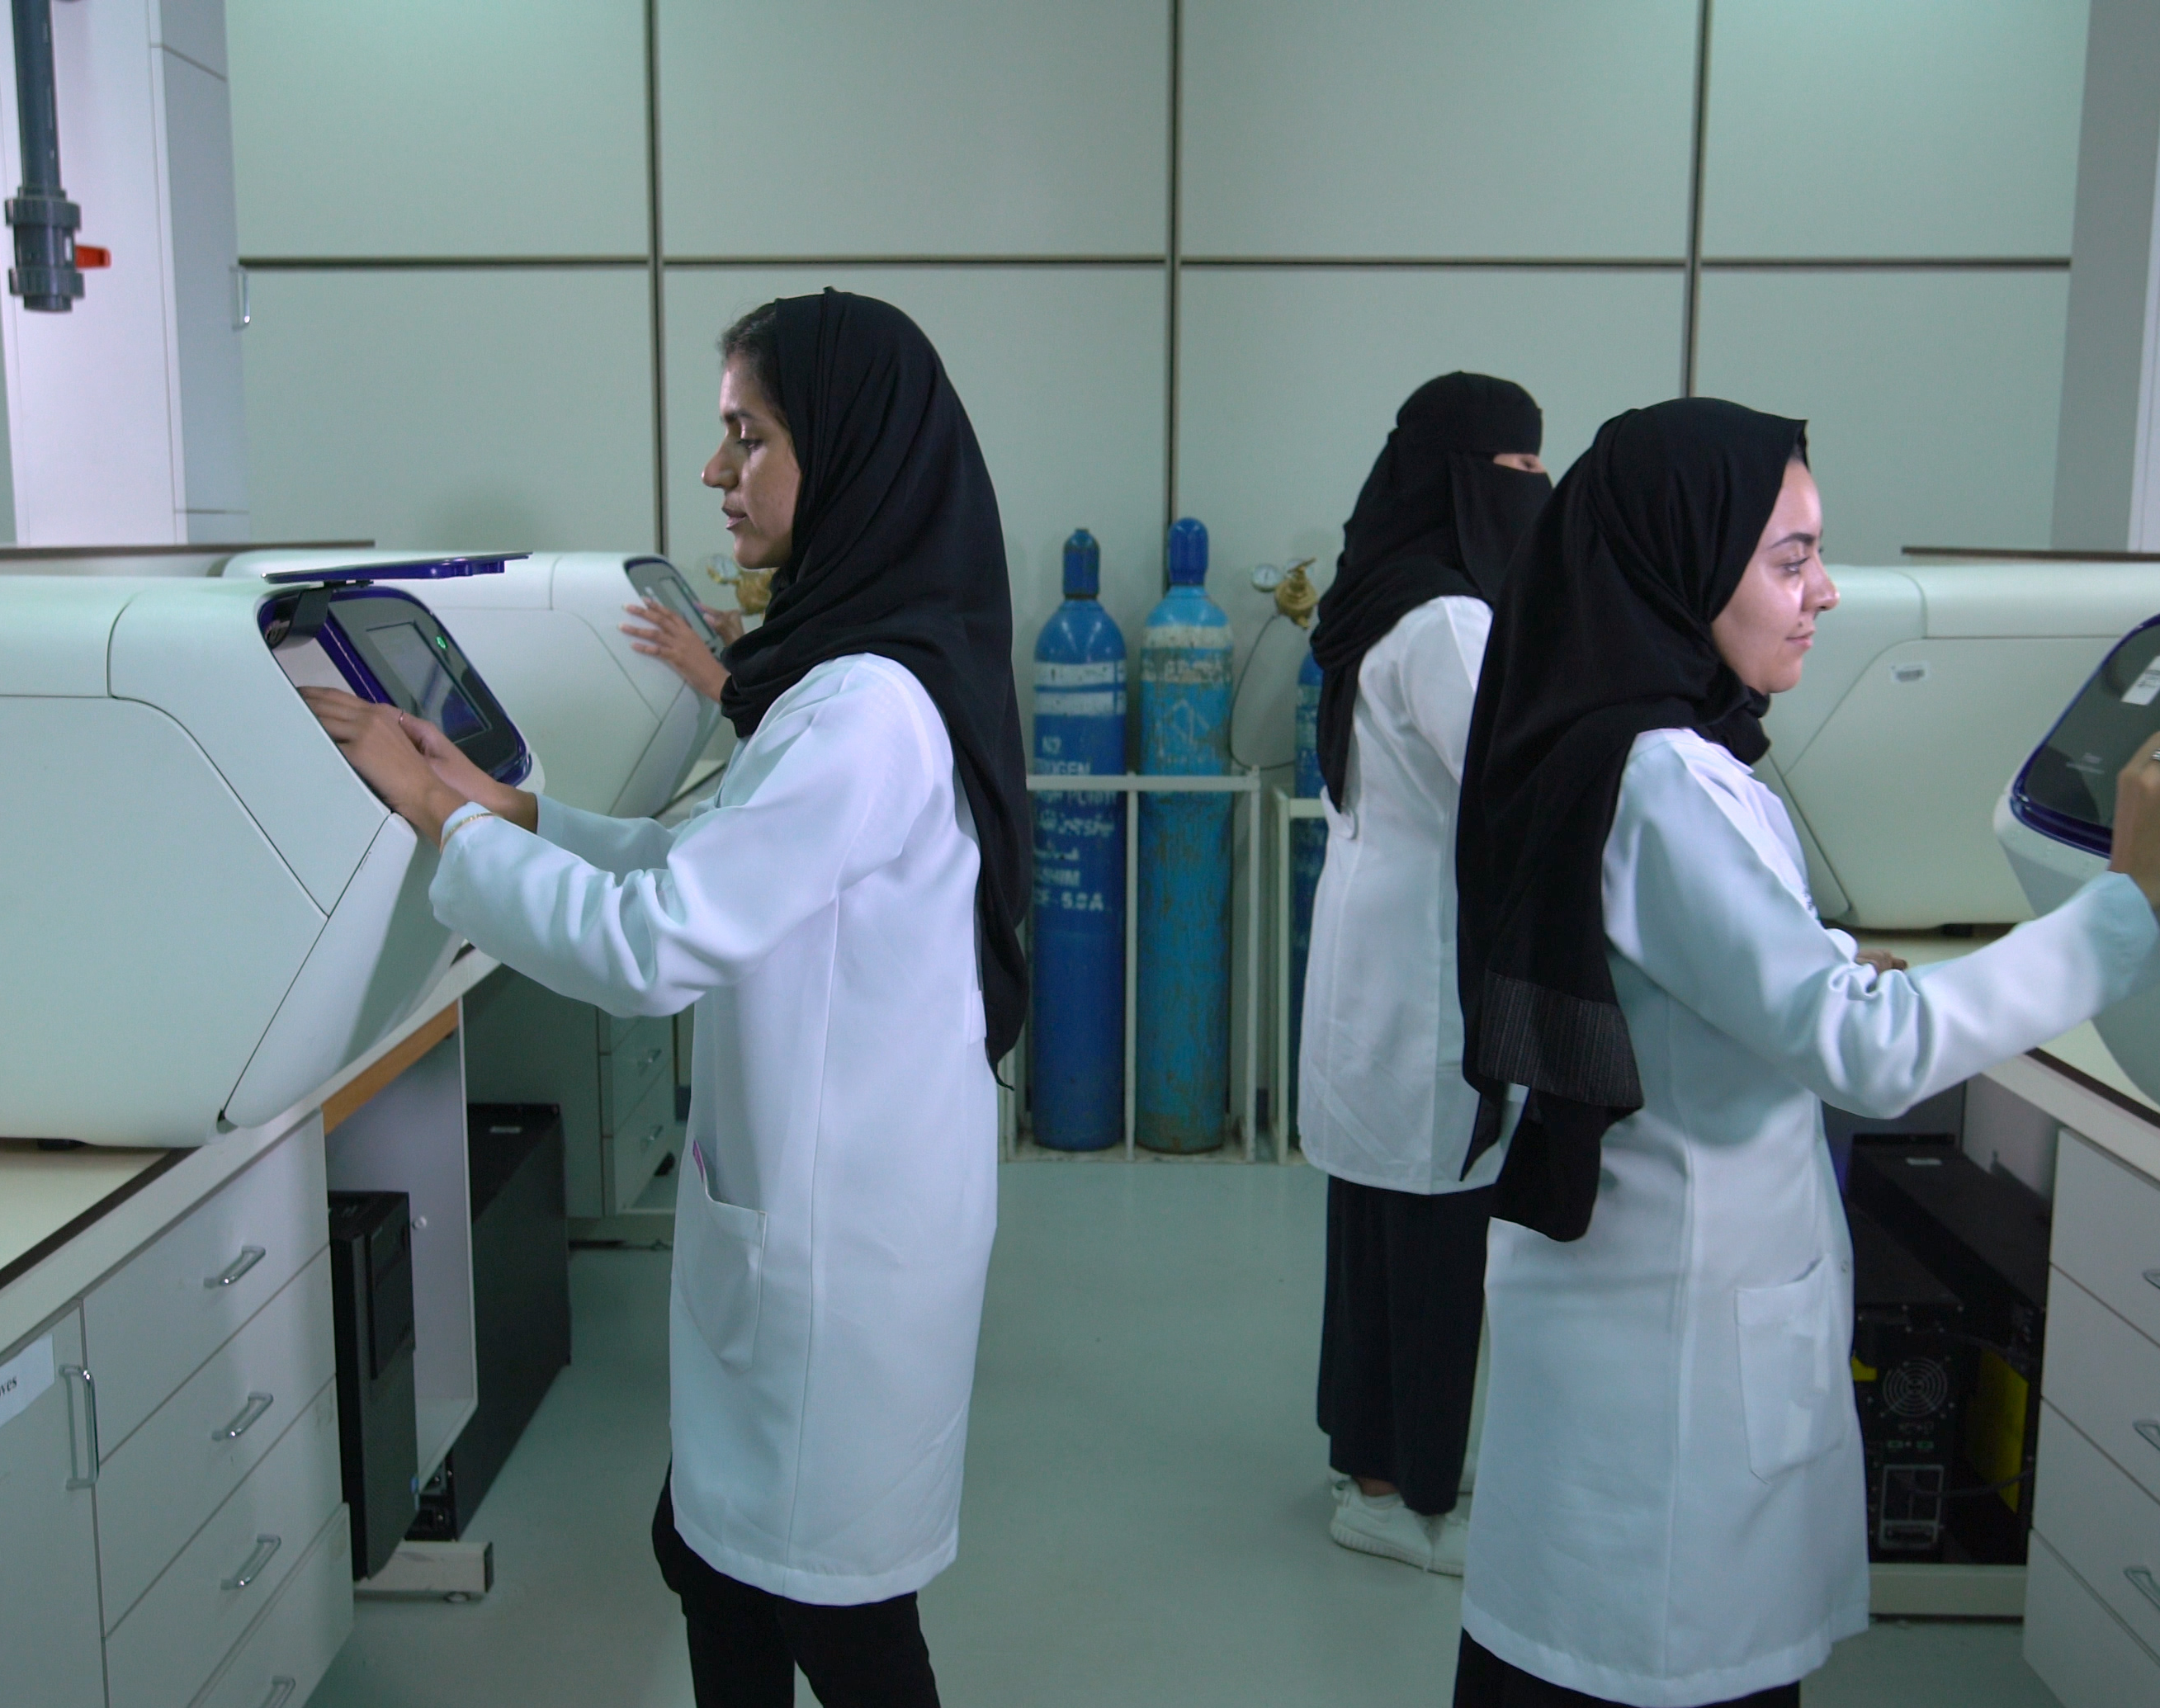
Saudi Human Resource Genome

Slide 16
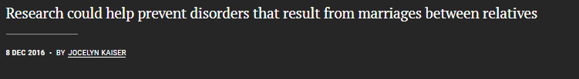
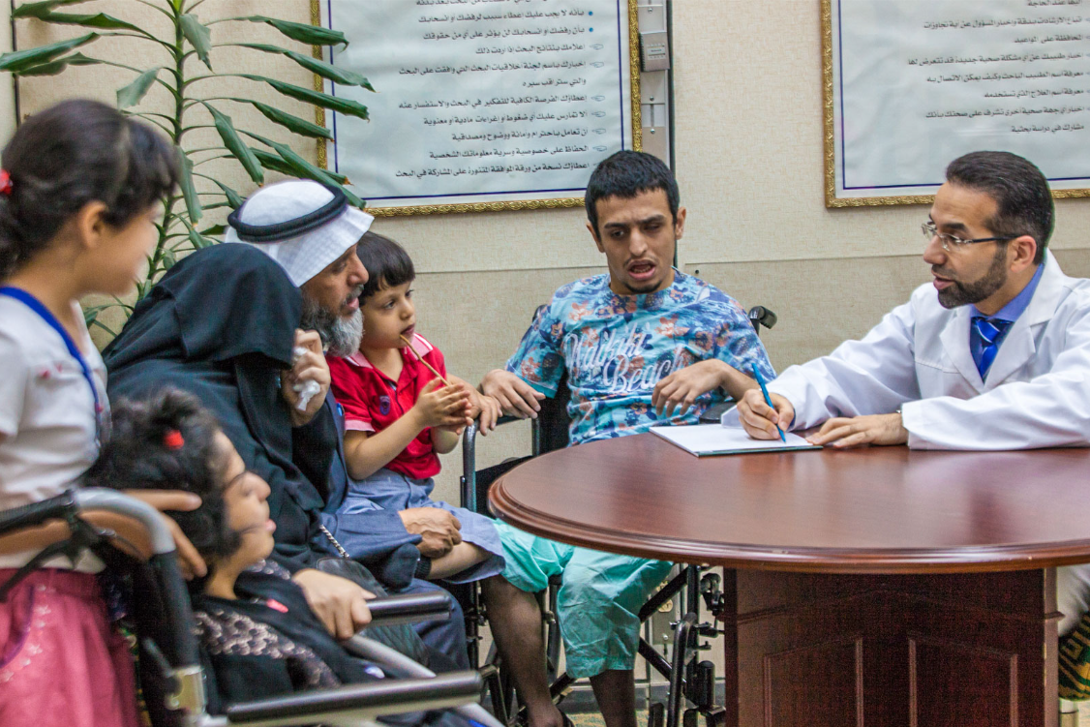
Saudi gene hunters comb country’s DNA to prevent rare diseases

Slide 17
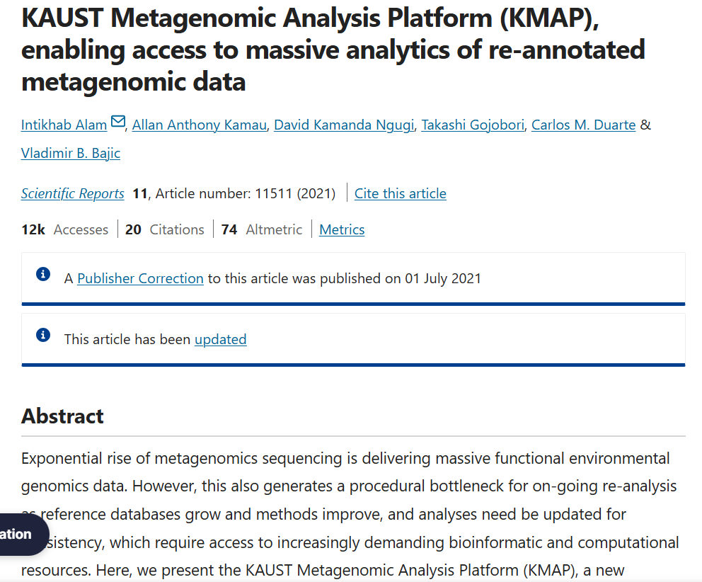
KMAP Platform

Slide 18
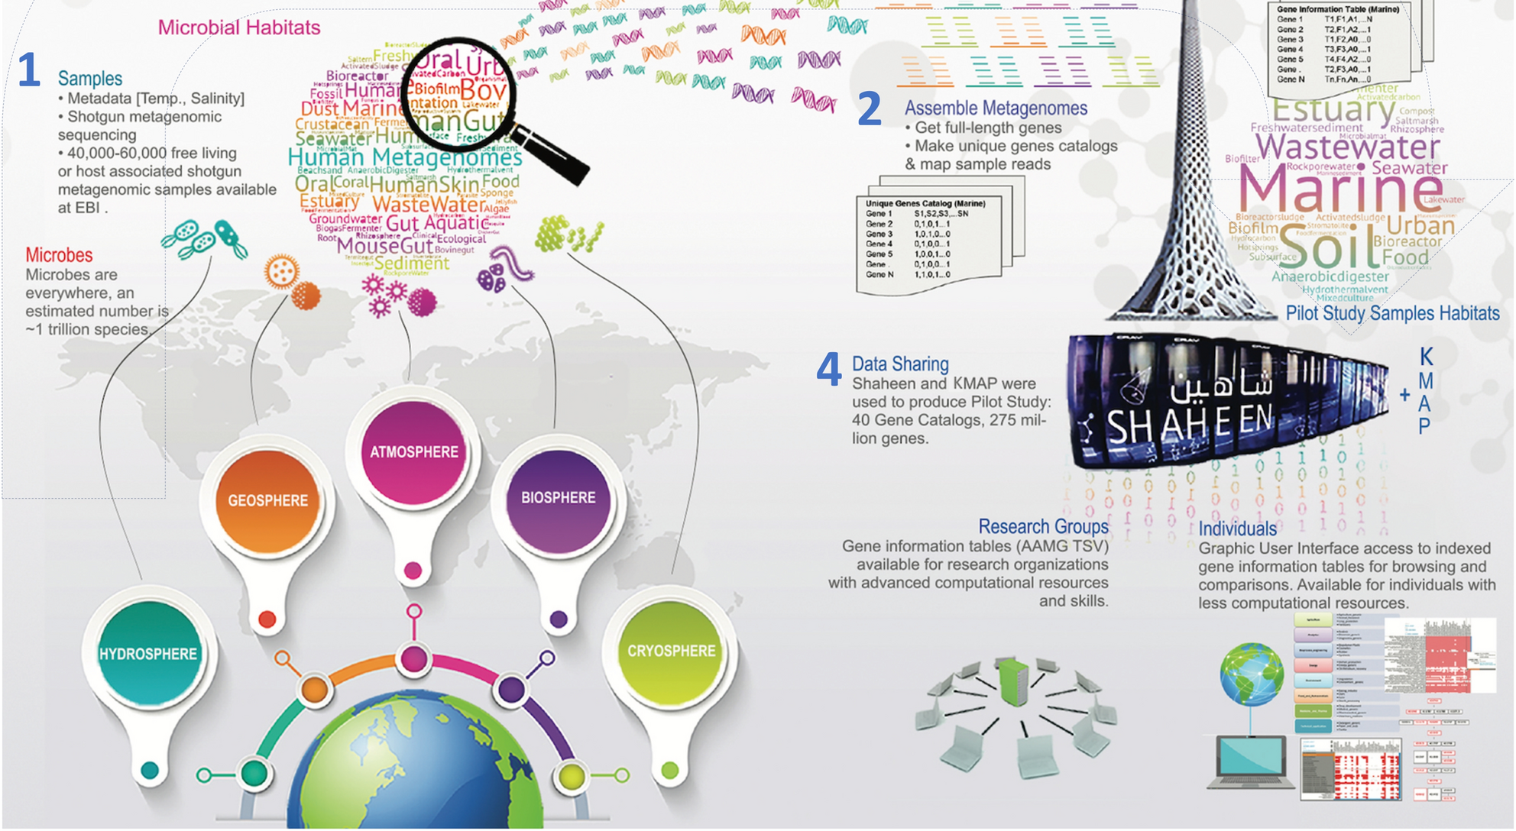

Slide 19
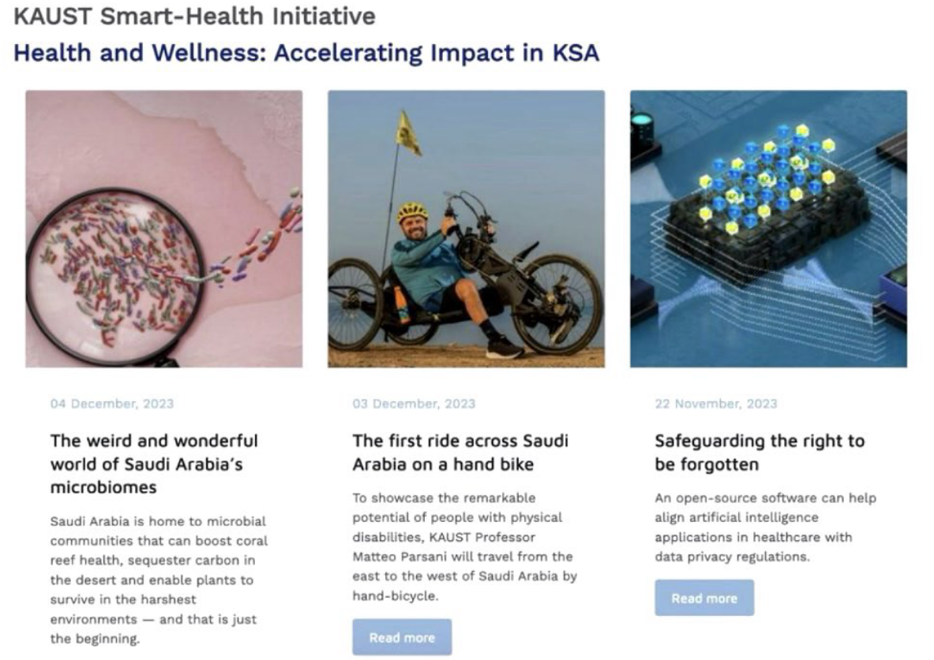

Slide 20
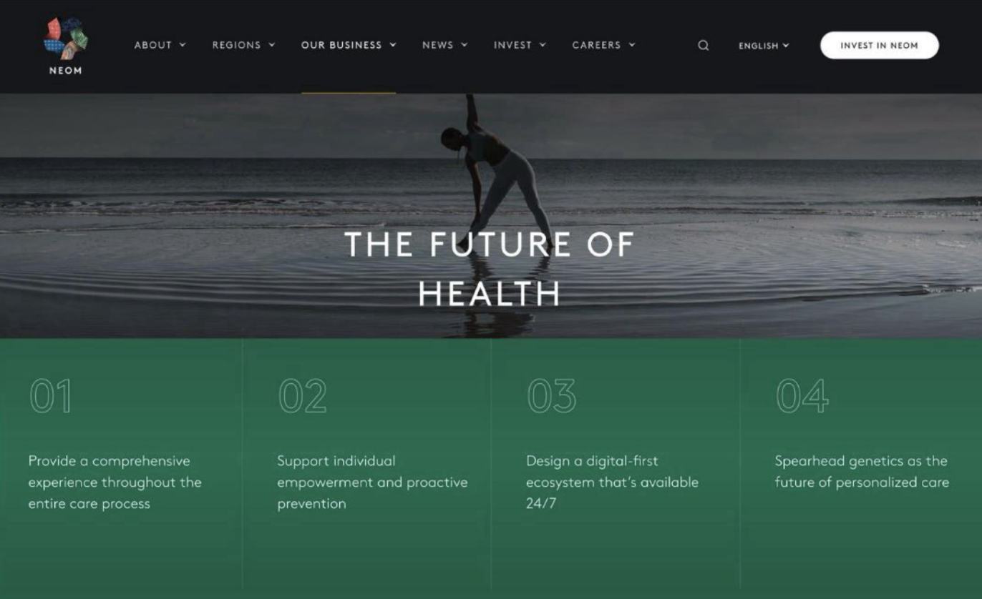

Slide 21
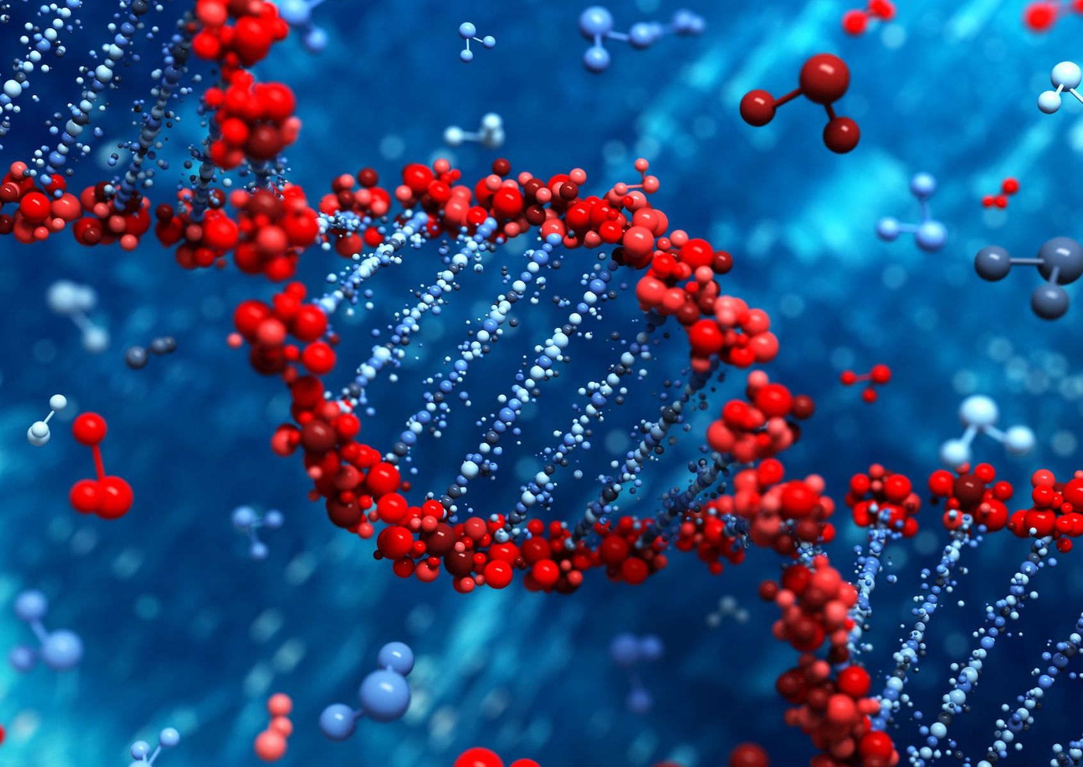
What is Molecular Biology?
The study of structure and function of nucleic acids and proteins of biological molecules to understand the molecular mechanisms underlying various biological processes

Slide 22
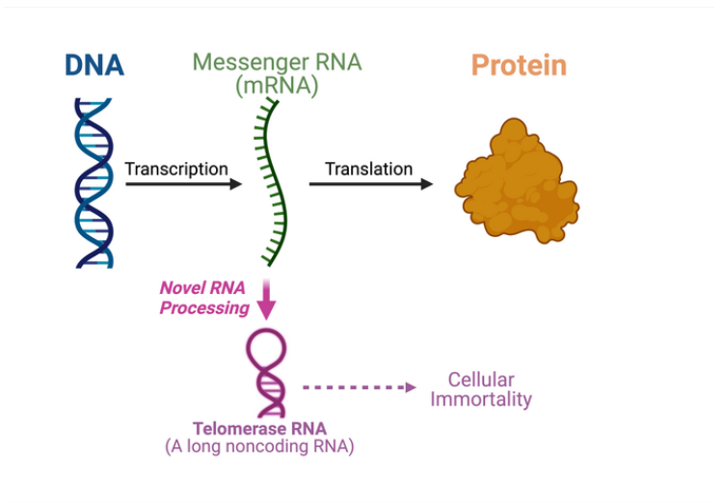
Basis of Molecular Biology: The Central Dogma

Slide 23
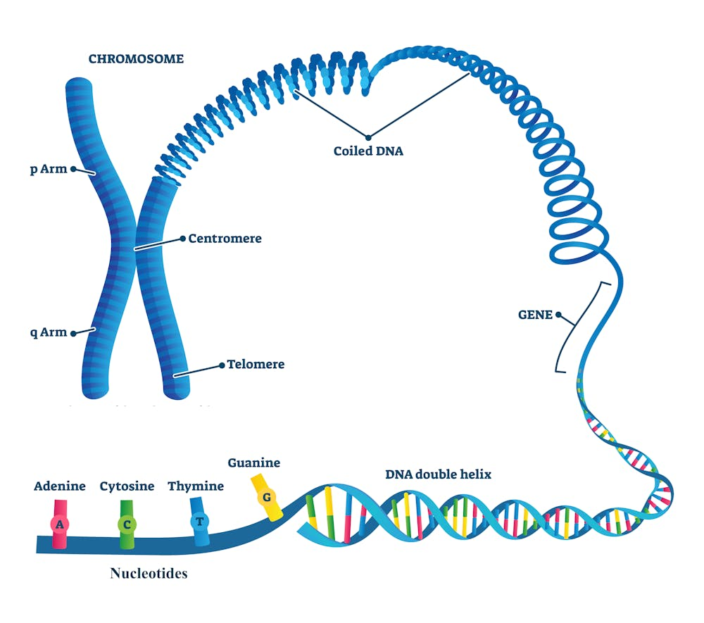
Human Genome
Chromosomes:
Humans have 46 chromosomes (22 pairs of autosomes pairs + 1 pair of sex chromosomes), containing1our genetic information.
Genes:
Specific segments of DNA that code for
proteins, which perform various functions in the body.
Nucleotide:
It is the building block of DNA and RNA, made up of a sugar, phosphate, and a nitrogenous base.

Slide 24
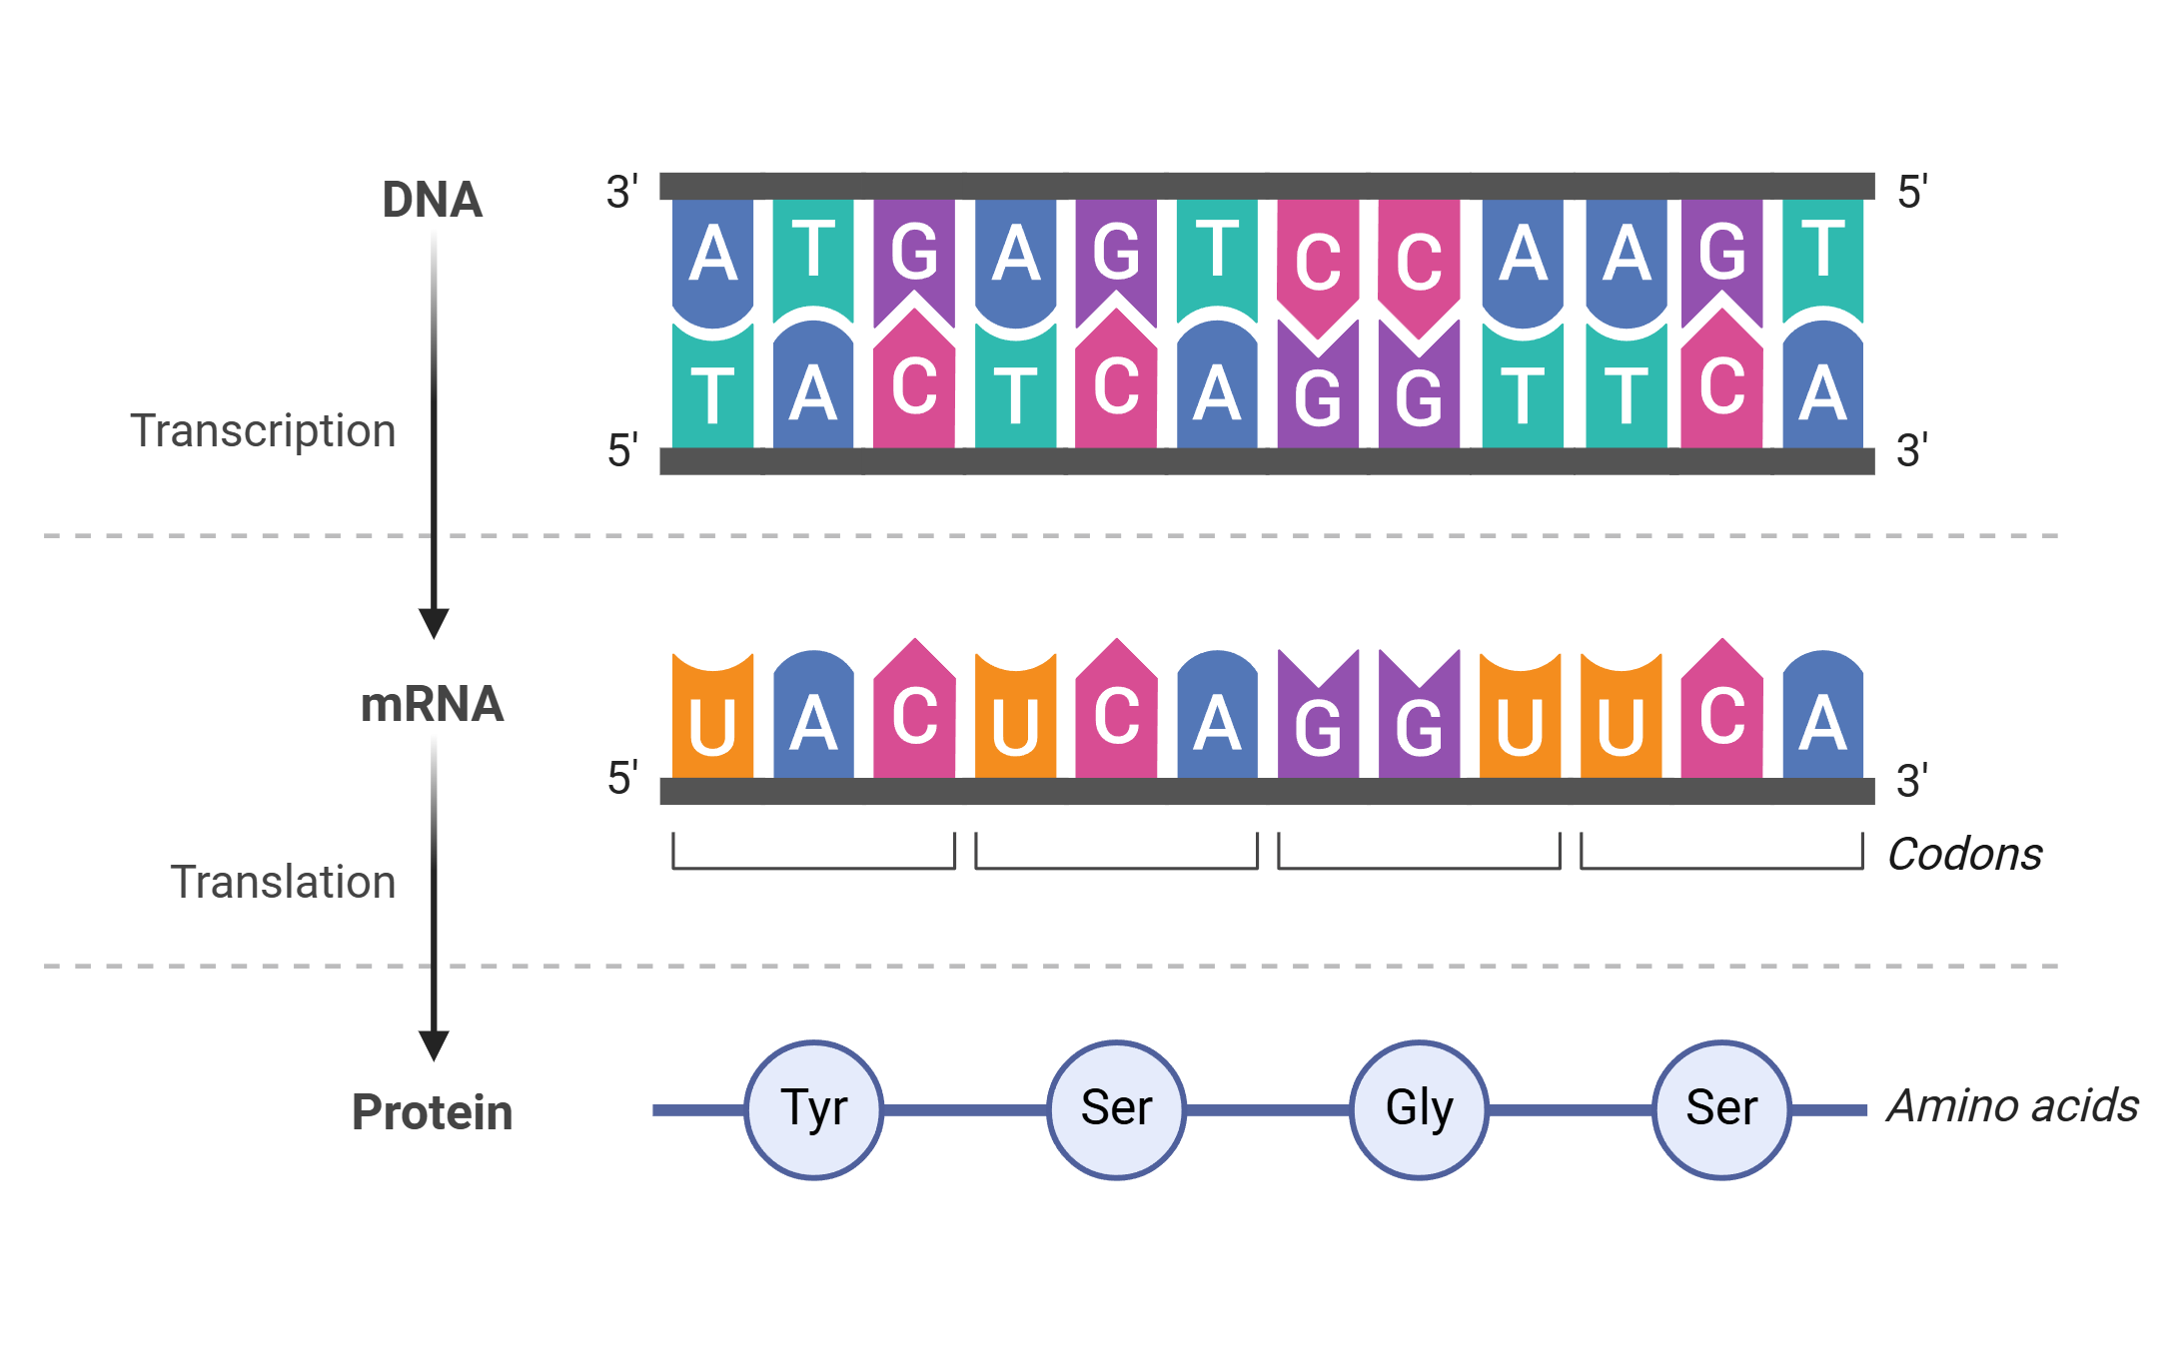
The Central Dogma Main Process

Slide 25
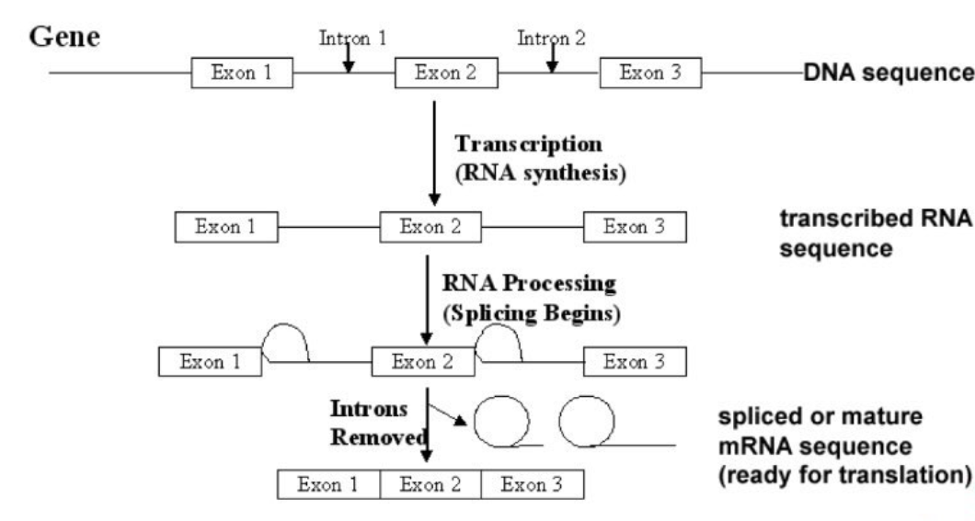
Exons (coding) and lntrons (non-coding)

Slide 26
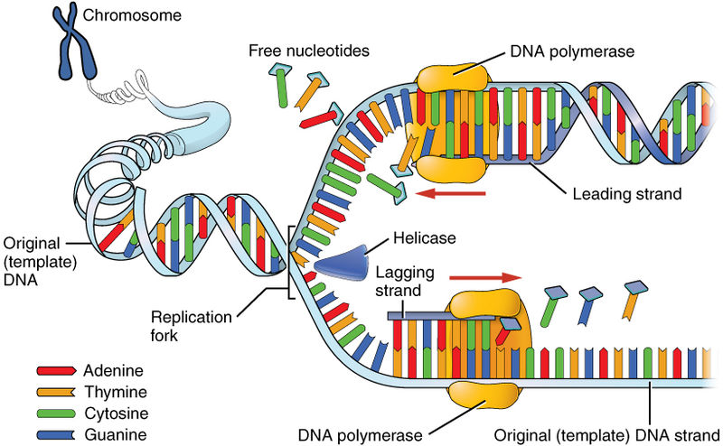
DNA Replication and Repair

Slide 27
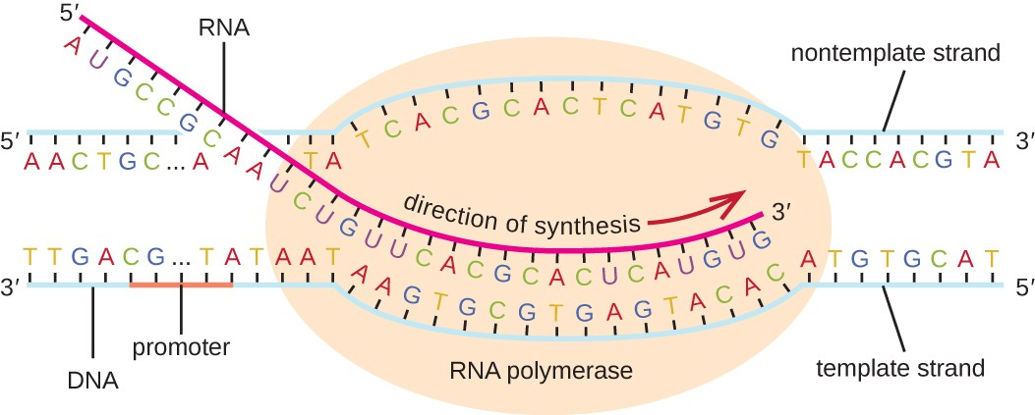
Transcription
Genetic information encoded in DNA is transcribed into RNA molecules, particularly messenger RNA (mRNA),which serves as a template for protein synthesis.

Slide 28
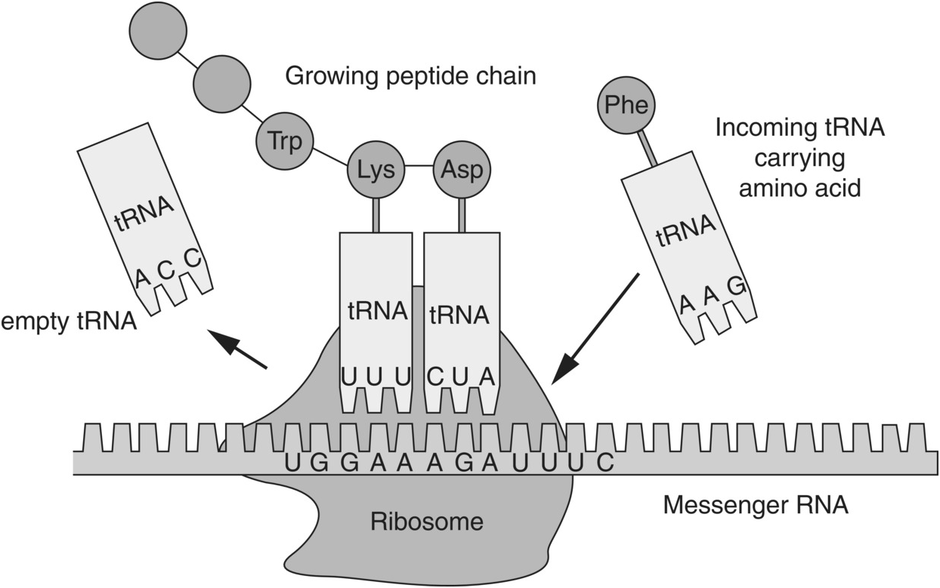
Translation
The process by which the information in mRNA is used to synthesize proteins, involving the interaction between mRNA, ribosomes, transfer RNA (tRNA), and amino acids.

Slide 29
Key Omics Disciplines in Bioinformatics

Slide 30
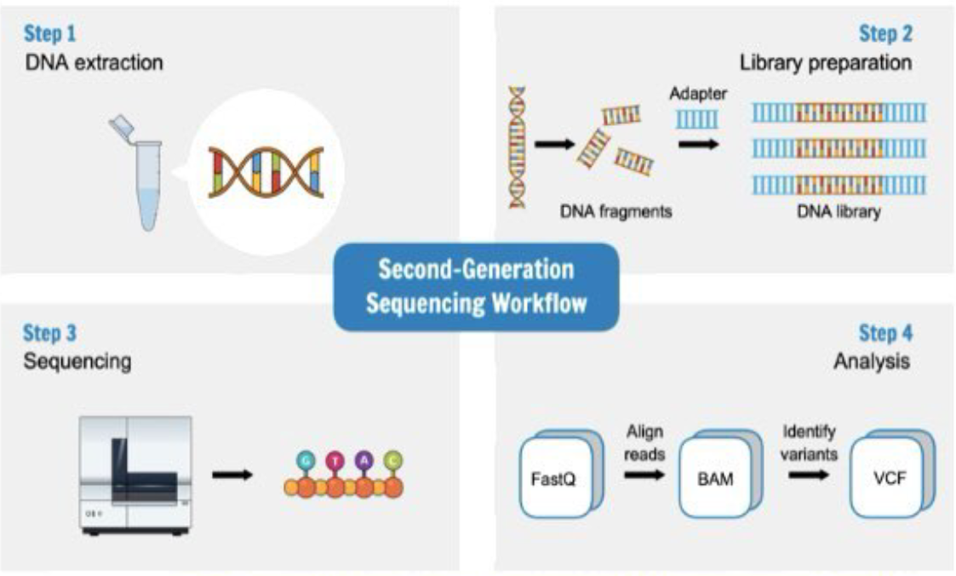
Genomics: Exploring DNA and Genetic Variations
DNA Sequencing:
Methods: Sanger sequencing (experimental), Next Generation Sequencing (NGS) (Computational)
Applications: Whole-genome sequencing, targeted sequencing

Slide 31
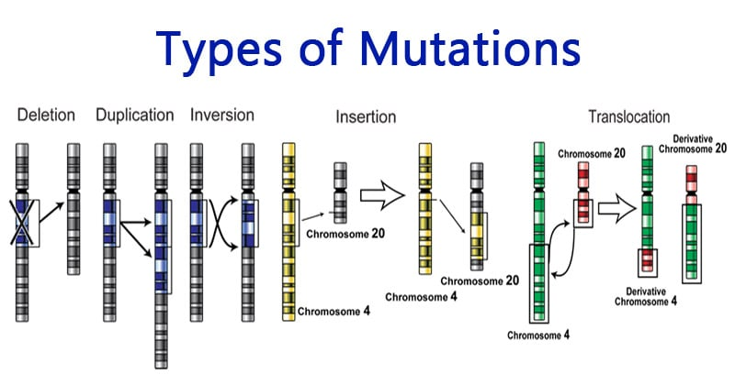
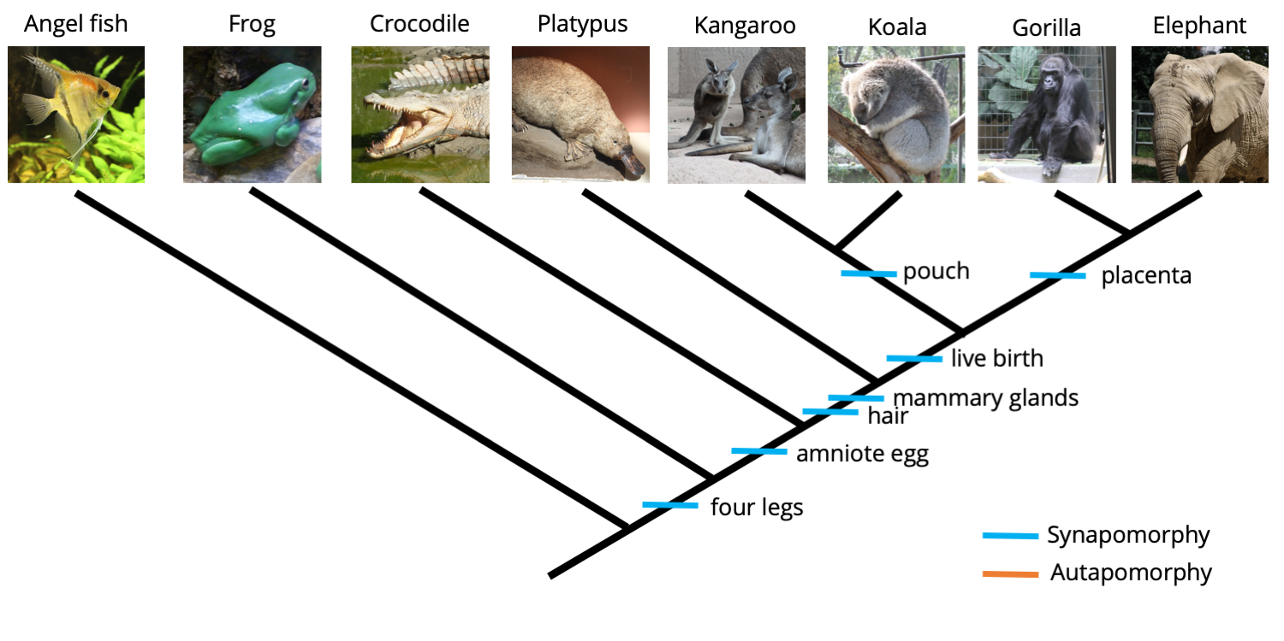
Genetic Variation and Evolution:
Mutations: Types (e.g., point mutations, insertions, deletions)
Linkage Disequilibrium: measures how often genetic variants are inherited together more than expected by chance due to their proximity on the same chromosome.
Phylogenetic Analysis: Tree construction, evolutionary relationships
Genomics: Exploring DNA and Genetic Variations

Slide 32
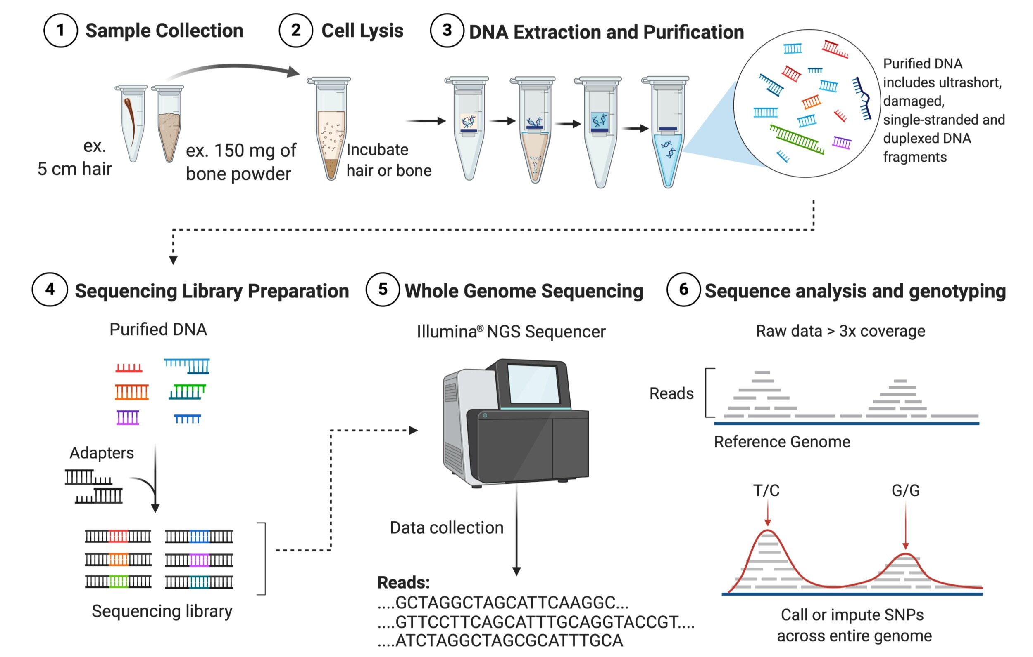
MetaGenomics: Exploring Microbial Communities
Analysis of Genetic-Material from Environmental Samples:
Techniques: DNA extraction, sequencing of environmental samples
Applications:
Studying microbial diversity, functional capabilities

Slide 33
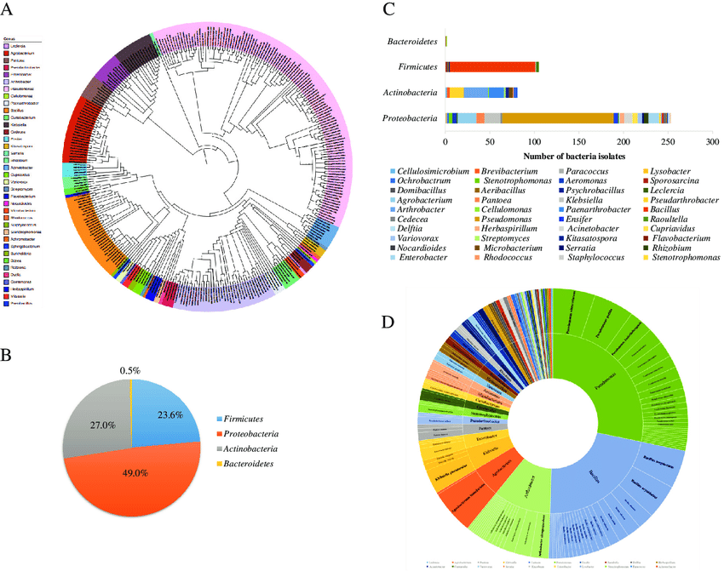
MetaGenomics: Exploring Microbial Communities
Microbial Diversity and Community Structure
Diversity: Richness, evenness of microbial species
Structure: Community composition, interactions

Slide 34
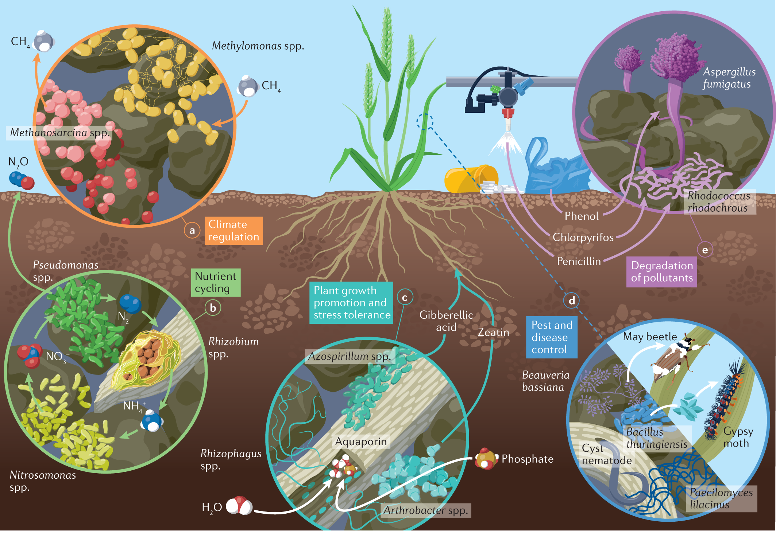
MetaGenomics: Exploring Microbial Communities
Functional Profiling:
Identifying Functions of microbial communities, potential roles in ecosystems.
Example: A metagenomics study of soil microbiomes revealed that the combination of Nitrosomonas (ammonia-oxidizing bacteria) and Nitrobacter (nitrite-oxidizing bacteria) works together to complete the nitrogen cycle. This collaboration converts ammonia into nitrate, enriching the soil for plant growth.

Slide 35
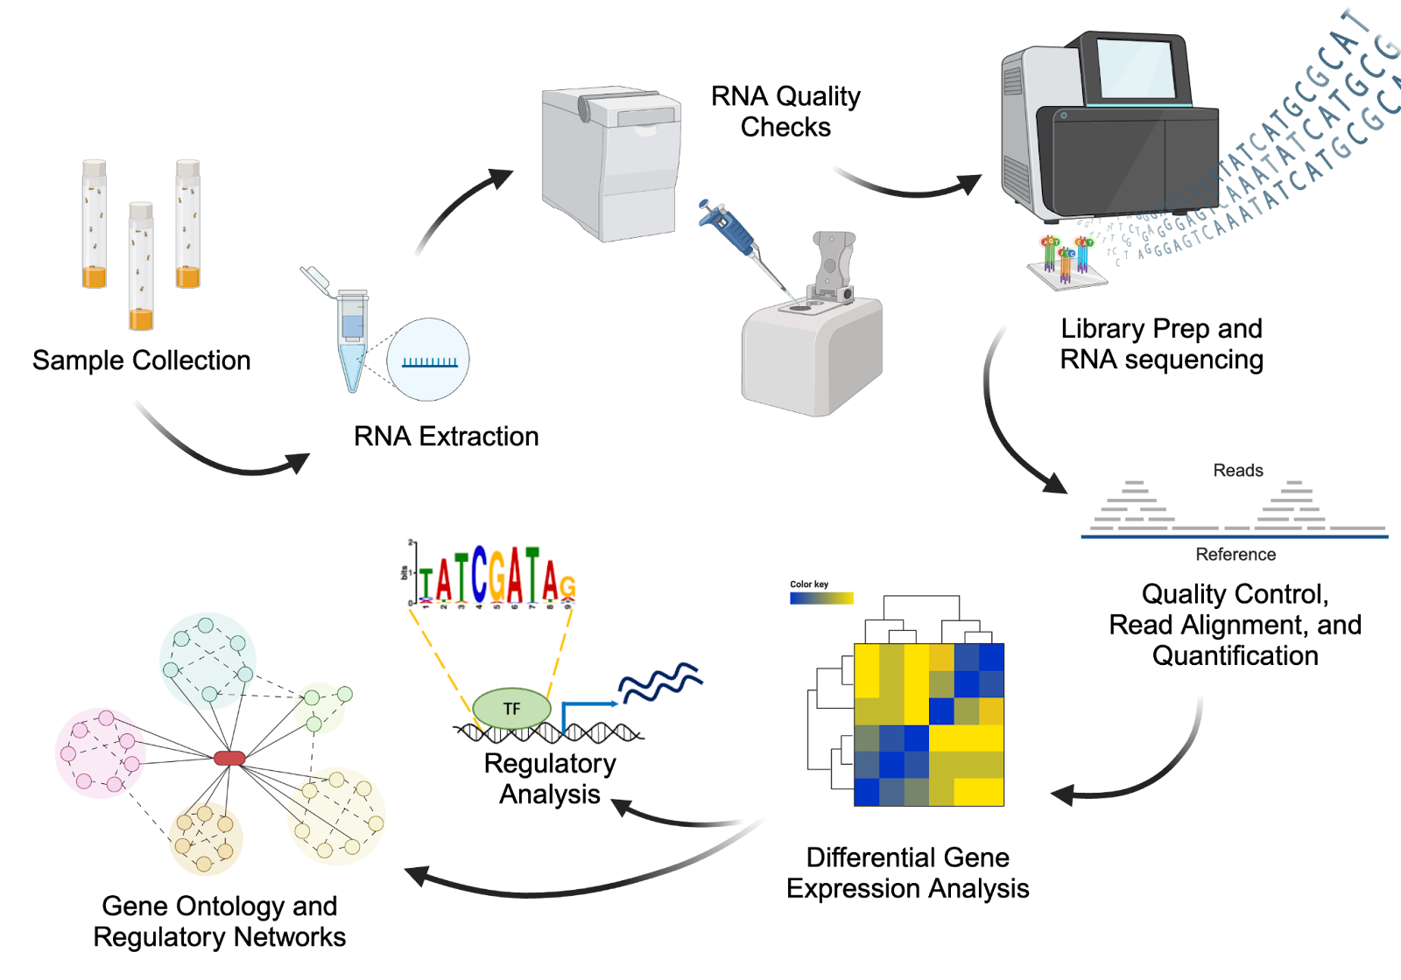
Transcriptomics: Understanding Gene Expression
RNA Sequencing (RNA-seq):
Technique: Sequencing of RNA to measure gene expression
Sample Applications :
i. Gene expression analysis
ii. Transcriptome profiling
( Mapping the full range of RNA molecules expressed in a cell or organism)

Slide 36
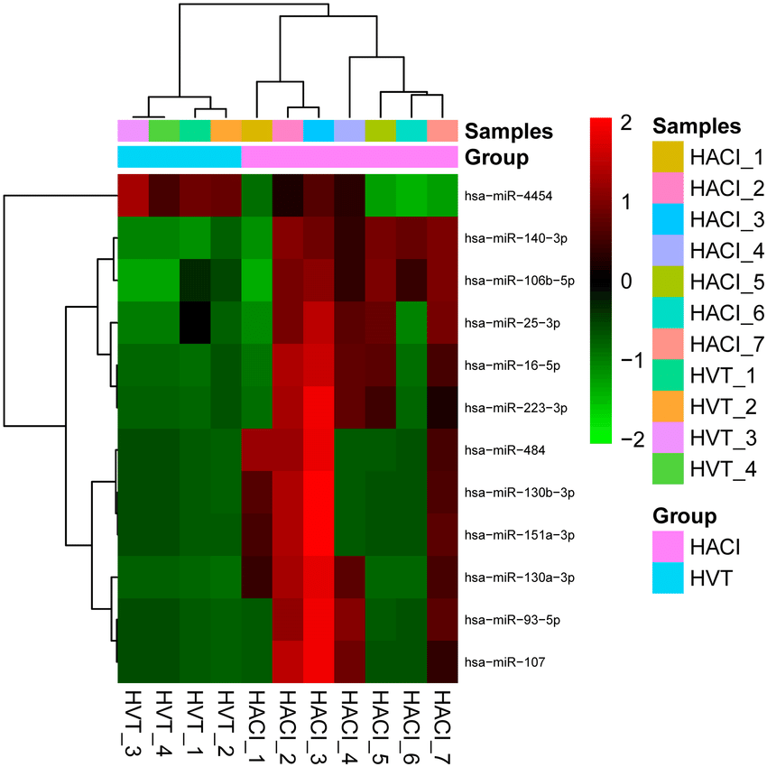
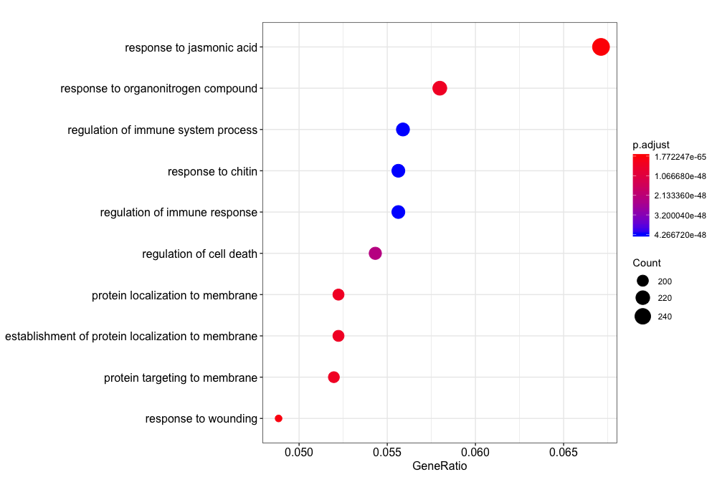
Transcriptomics: Understanding Gene Expression
Gene Expression and Regulation:
Microarrays:
Technique for measuring expression levels of thousands of genes
Gene Function:
Insights into regulatory mechanisms, functional annotation

Slide 37
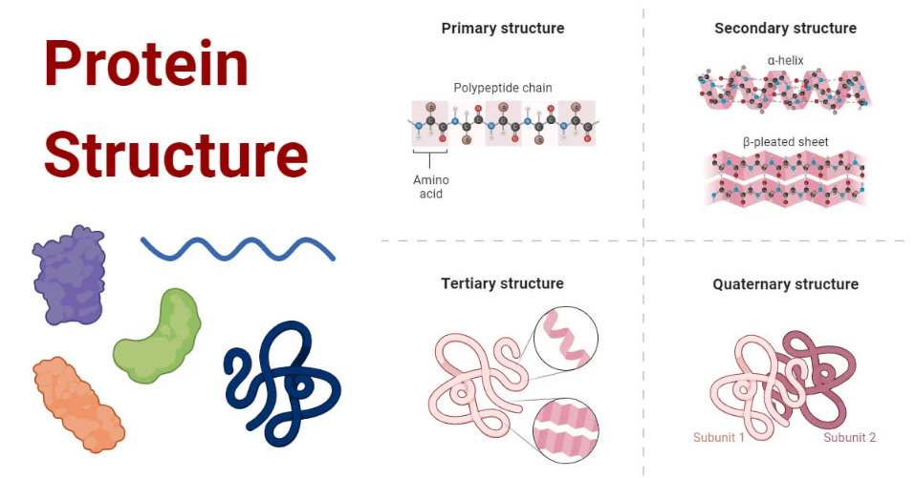
Proteomics: Analysing Proteins and Their Functions
Protein Sequences:
Techniques: Mass spectrometry, protein sequencing
Applications: Identifying proteins, characterizing protein sequences
Protein Folding and Function:
Folding: importance of protein structure (primary, secondary, tertiary)
Function: Enzymatic activity,
interaction with other molecules

Slide 38
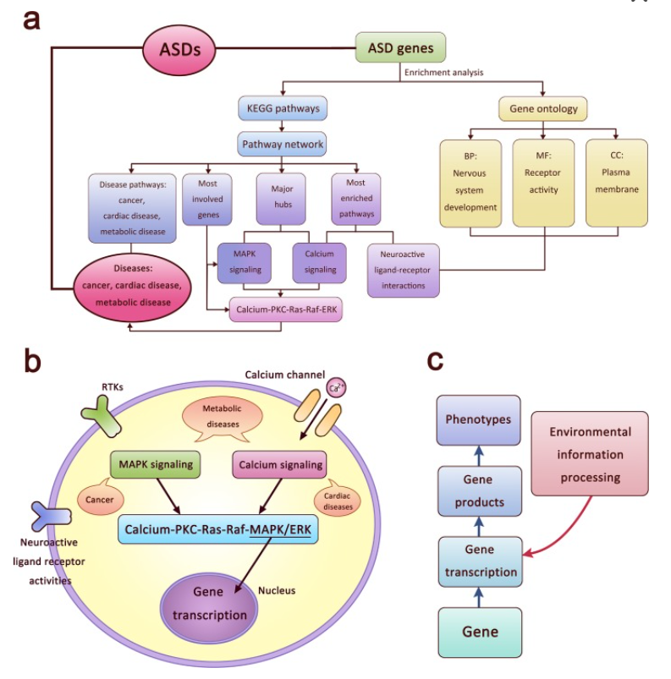
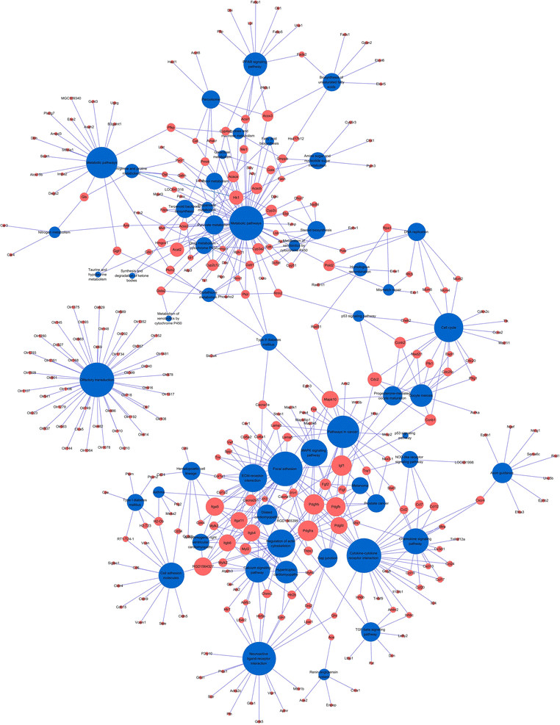
Proteomics: Analysing Proteins and Their Functions
Protein Networks and Molecular Pathways:
Networks: Interaction networks, signaling pathways
Pathways: Cellular processes, disease mechanisms

Slide 39
Lunch Break

Slide 40
Day 1: Introduction to Bioinformatics and Biological Resources Afternoon Session

Slide 41
Outline Day 1
Afternoon (2-5 pm):
Biological Resources:
Types of biological databases/resources: Sequence, structure, functional.
Overview of genomic, transcriptomic,, and proteomic databases/resources.
Practical Session:
Primary Option: Query databases like GenBank, PDB, and KEGG (web-based).
Alternative: Access and query these databases using Google Golab.

Slide 42
Data and Information
Data
Raw, unorganized facts that need to be processed to gain meaning.
Example: Exam scores of ind1iv1idual students.
Information
When data is processed, organised, structured, or presented in a given context to make it useful.
Example: The average ,exam score of a cl1ass..
Knowledge
Information that is understood, interpreted and applied based on experience or learning. It reflects insights gained from analyzing and understanding information.
Examples: Knowing how to improve student performance based on exam score trends

Slide 43
Biological Data
1. Sequence Data
Description: Linear sequences of nucleotides (DNA, RNA) or amino adds (proteins).
Examples: DNA sequences (A, T, G, C), RNA sequences (A, U, G, C), and protein sequences (chains of amino acids).
Use Cases: Genome annotation, gene expression studies, protein synthesis understanding.
2. Structural Data
Description: Information about the 3D arrangement of biological molecules, particularly proteins.
Examples: Primary, secondary, tertiary, and quaternary structures of proteins, often visualized in 3D models.
Use Cases: Drug design, understanding protein interactions, and enzyme functionality.
3. Functional Data
Description: Data related to the function or activity of genes and proteins.
Examples: Gene ontology, metabolic pathways, enzyme kinetics.
Use Cases: Functional genomics, pathway analysis, metabolic modeling.

Slide 44
Biological Data
4. Expression Data
Description: Information about gene or protein expression levels, often measured through experiments.
Examples: RNA-seq data, microarray data, proteomics data (mass spectrometry).
Use Cases: Identifying differentially expressed genes or proteins in conditions like disease.
5. Interaction Data
Description: Describes interactions between biomolecules (e.g., protein-protein, protein-DNA, or protein-RNA interactions).
Examples: Protein interaction networks, gene regulatory networks, signaling1pathways.
Use Cases: Understanding cellular processes, pathway reconstruction, systems biology.
6. Phenotypic Data
Description: Data that captures observable traits or characteristics of an organism.
Examples: Disease phenotypes, clinical trial data, morphological traits.
Use Cases: Genome-wide association studies (GWAS), personalised medicine, trait mapping.

Slide 45
Biological Data
7. Time-Series Data
Description: Data collected at regular intervals over time, often used to study changes in biological systems.
Examples: Heart rate, EEG, gene expression over time.
Use Cases: Longitudinal studies, circadian rhythm research, real-time monitoring of biological processes.
8. Textual Data
Description: Written descriptions and annotations associated with biological data.
Examples: Clinical notes, literature reviews, gene annotations.
Use Cases: Mining biological literature, natural language processing (NLP) applications., clinical research.
9. Image Data
Description: Visual representations of biological structures or experimental results.
Examples: Microscopy images, MRI scans, electrophoresis gels.
Use Cases: Cell imaging, diagnostic imaging, protein visualization

Slide 46
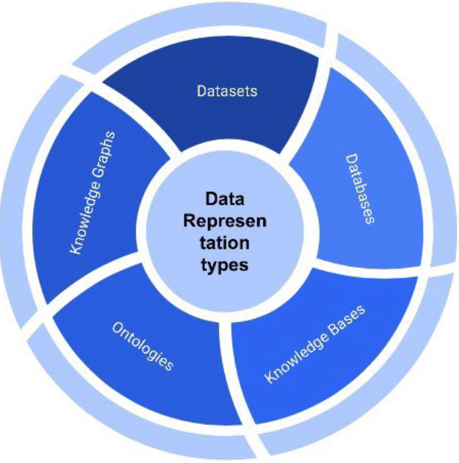
Biological Data Representation Types
Datasets: Raw collections of biological data
Databases: Structured repositories
Knowledge Bases:
Integrated collections of
curated information with annotations and additional context
Ontologies: Formalized representations of knowledge with structured concepts and their relationships.
Knowledge Graphs: Graph-based representations that map relationships between biological entities and their attributes.

Slide 47
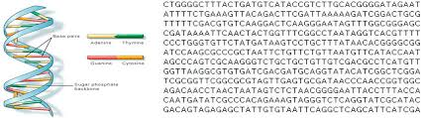
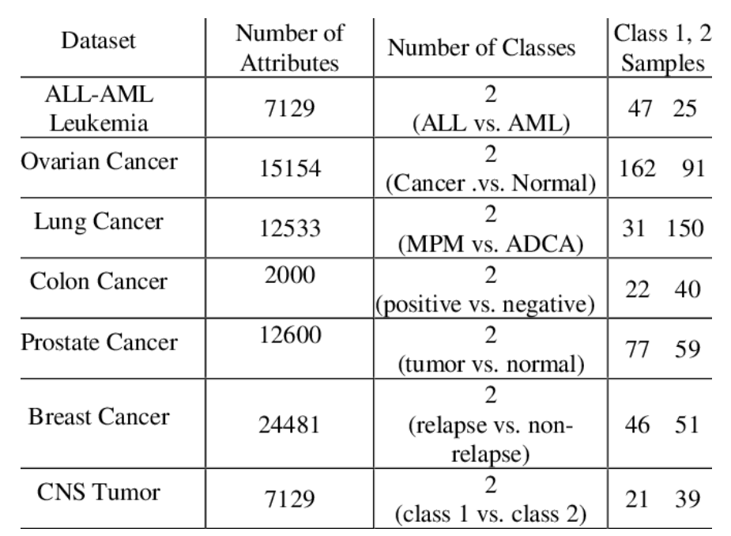
Biological Datasets
Description: Raw data collected from experiments; observations, or simulations, usually in a structured format like tables.
Examples:
Genomic sequences: FASTA, FASTQ files containing DNA or RNA sequences
Transcriptomic data: RNA-seq data matrices
Proteomic data: Mass spectrometry-based proteomics datasets.
Images
Applications:
Data mining
Statistical analysis
Comparative studies

Slide 48
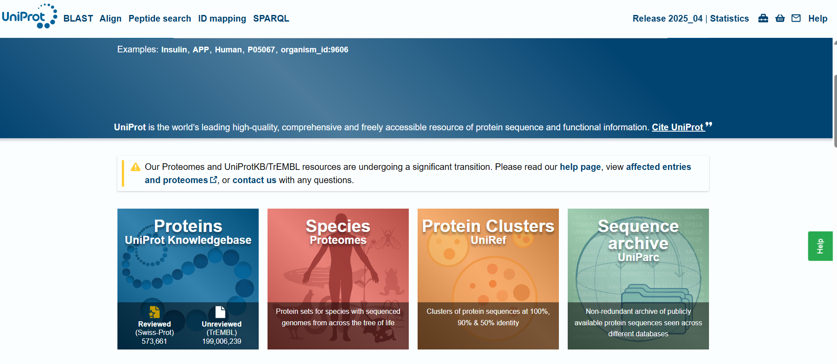
Biological Datasets
Description: Structured collections of biological data curated for easy retrieval, usually organized and searchable by specific
criteria.
Examples:
NCBI GenBank: DNA and RNA sequences
UniProt: Protein sequences and functional information
PDB (Protein Data Bank): 3D structures of proteins and nucleic acids
Applications:
Data retrieve
Sequence alignment
Structural prediction

Slide 49
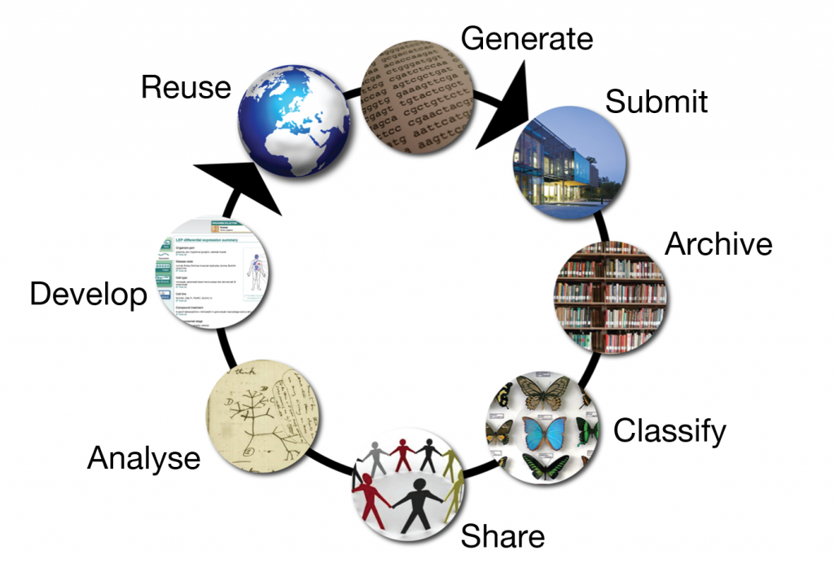
The Role of Public Databases
Bioinformatics centres of excellences:
The EMBL-European Bioinformatics Institute (EMBL EBl)
The US National Centre for Biotechrmlogy Information (NCBI)
The National Institute of Genetics in Japan (NIG).

Slide 50
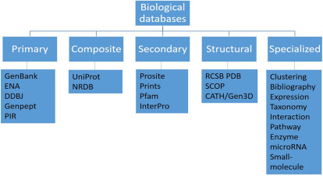
Types of Biological Databases
On the basis of nature of data

Slide 51
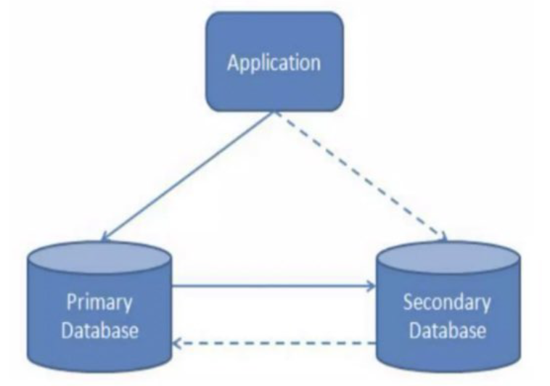
Types of Biological Databases
Based on the manner of storage

Slide 52
Primary Databases
Biomolecular data are stored in the original form
Experimental results are submitted directly by researchers into these databases, serving as archival repositories.
Contents controlled by the submitter.
Once an accession number is assigned to the data, it cannot be changed or modified.
Examples:
GenBank
EMBL-EBI (ENA (European Nucleotide Archive), PRIDE, Array Express, Bioimage Archive)
DDBJ
PDB

Slide 53
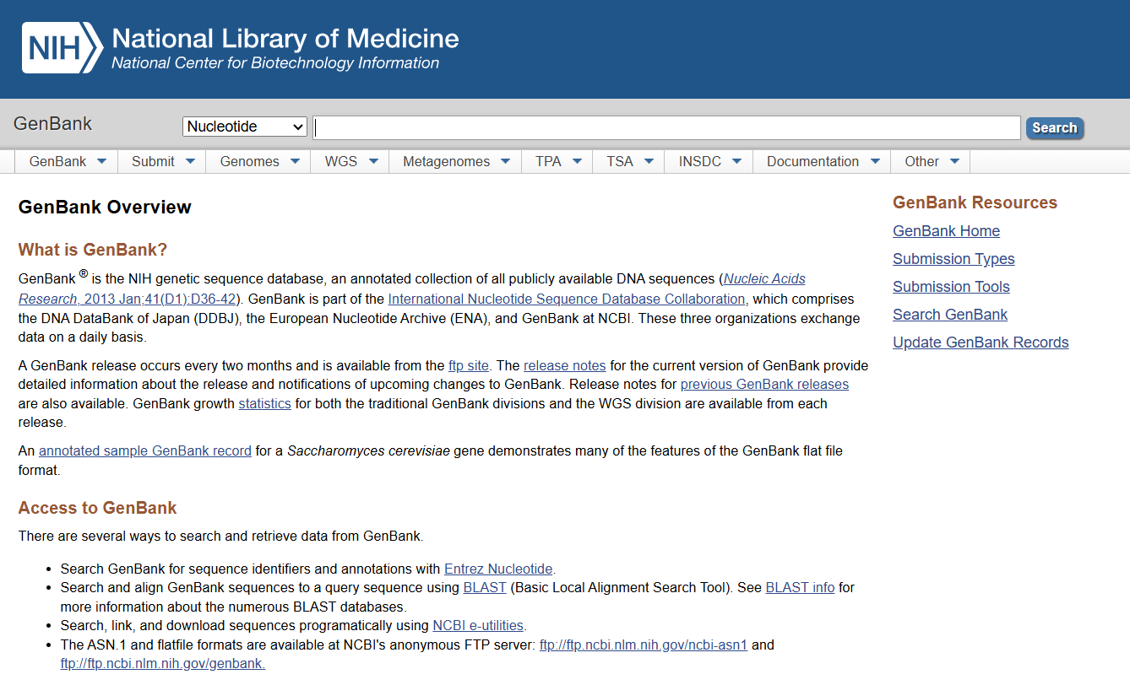
GeneBank
A comprehensive genetic sequence, database hosted by NCBI.
Provides publicly available DNA sequences from various species, contributing to global research.
Part of the international Nucleotide Sequence Database Collaboration (INSDC) alongside DDBJ and EMBL-EBI.

Slide 54
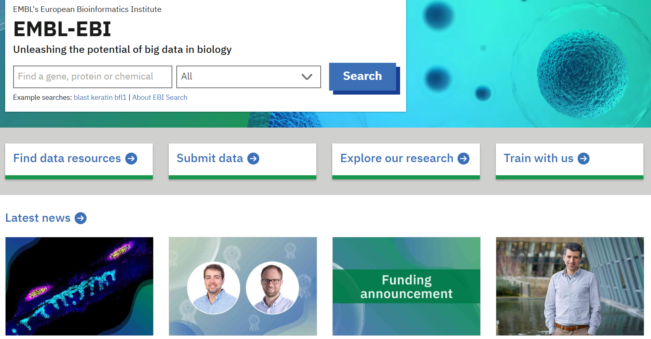
European Molecular Biology Laboratory
European Bioinformatics Institute (EBI) is part of the EMBL and provides bioinformatics services and research
Hosts a variety of biological databases
ENA (European Nucleotide Archive): Raw DNA and RNA sequences,
PRIDE: Raw proteomics data (mass spectrometry)
ArrayExpress: Raw transcriptomics data
(microarray or RNA-seq datasets)
Biolmage Archive: Raw biological images from various experimental techniques.

Slide 55
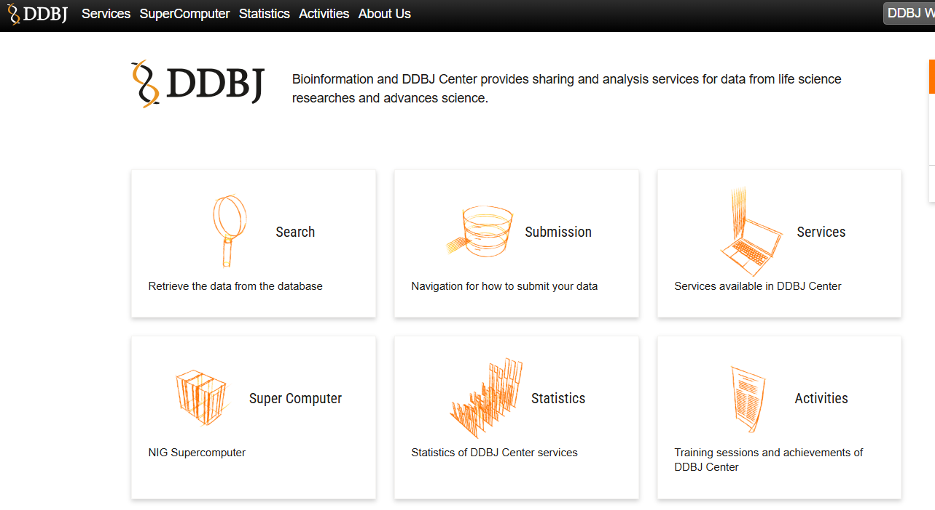
DDBJ
The DNA Data Bank of Japan (DDBJ) is a biological database that collects DNA sequences.
DDBJ is a member of the International Nucleotide Sequenoe Database Collaboration (INSDC).

Slide 56
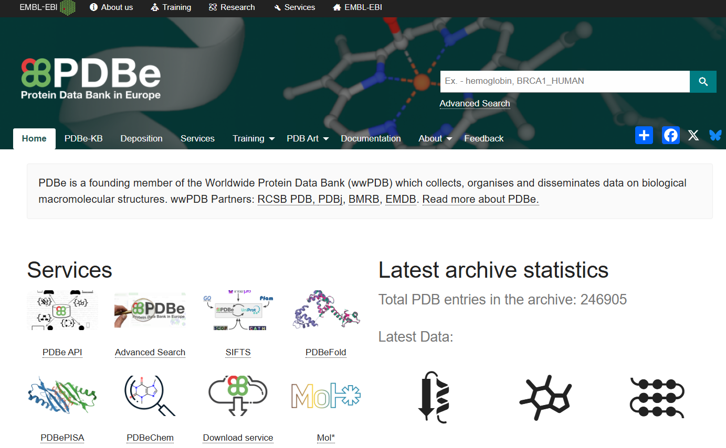
Protein Data Bank (PDB)
Contains 3D structures of proteins, nucleic acids, and complexes from experimental data.
Global Collaboration:
Managed by RCSB PDB (USA), PDBe (EMBL-EBL UK), and PDBj (Japan).

Slide 57
Secondary Databases
Derives data from analysed primary data
Contains manually created or automatically generated data
Contents of secondary db controlled by a third party
EMBL's secondary databases :
UniProt: A protein sequence and function database that curates and annotates protein sequences based on raw data from primary sources.
lnterPro: Classifies proteins into families and predicts domains based on protein sequences.
Pfam: Provides protein family annotations using hidden Markov models (HMMs) derived from primary protein sequence data.
Reactome: A curated pathway database detailing biological processes.
SIB
Swiss-Prat
PROSITE
NCBI
PubMed

Slide 58
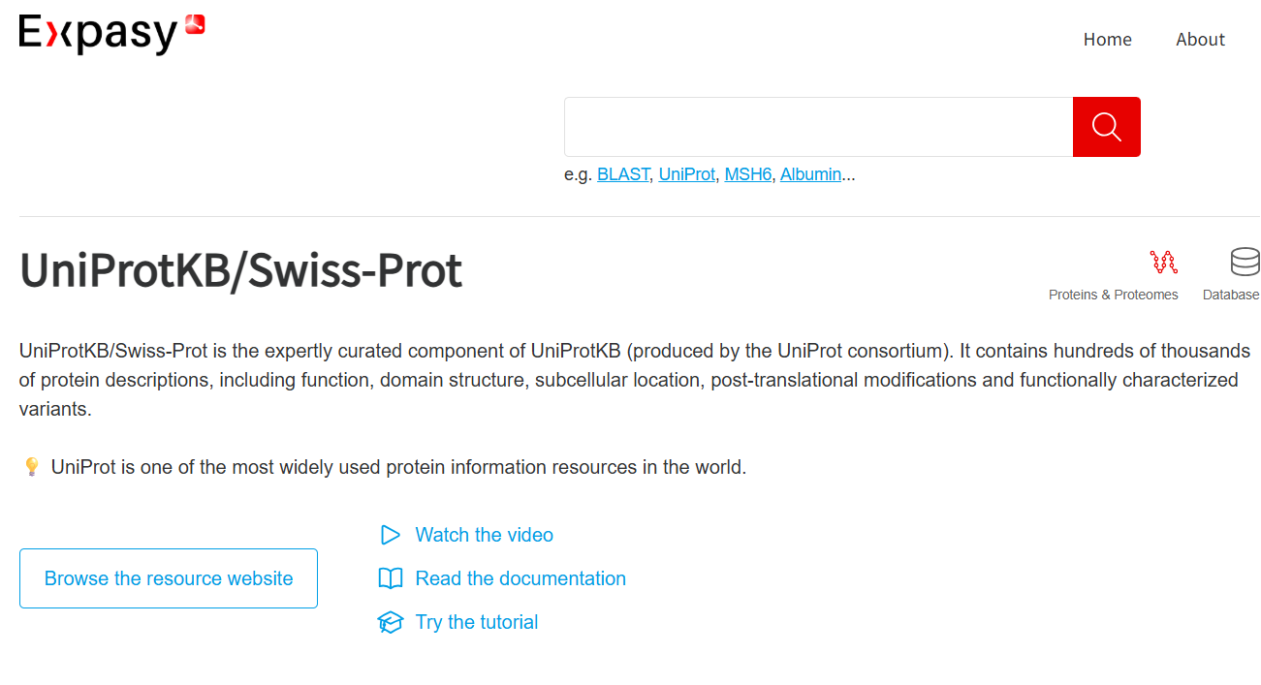
Swiss-Prot
SWISS-PROT is a curated protein sequence database.
Aims to provide a high level of annotation, including:
Protein function descriptions
Domain structures
Post-transIationaI modifications
Variants
Swiss -Prat was created in 1986 by Amos Bairoch in collaboration with the Swiss Institute of Bioinformatics.

Slide 59
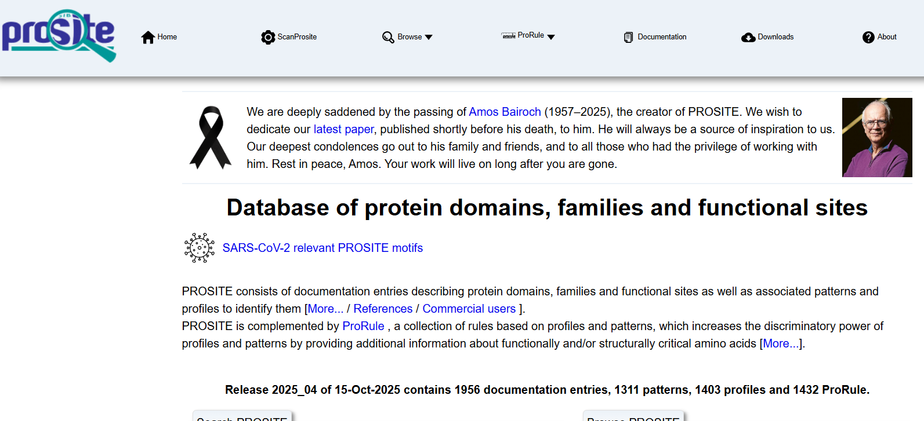
PROSITE
Protein database
Integrated with Swiss-Prot protein annotation
Contains entries describing:
Protein families
Domains
Functional sites
Amino acid patterns and profiles
Integrated with Swiss-Prot protein annotation

Slide 60
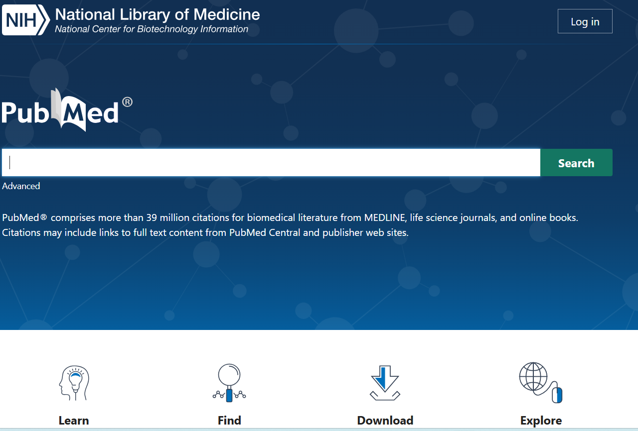
PubMed
Complementary Resource: Enhances primary literature searches with MEDLINE’s extensive biomedical references.
Supplementary Access: Links to full text articles and resources beyond primary databases.
Integrated Citations: Provides citation tracking and related articles, complementing primary data sources.
Rich Metadata: Offers detailed abstracts and indexing to support in-depth research.

Slide 61
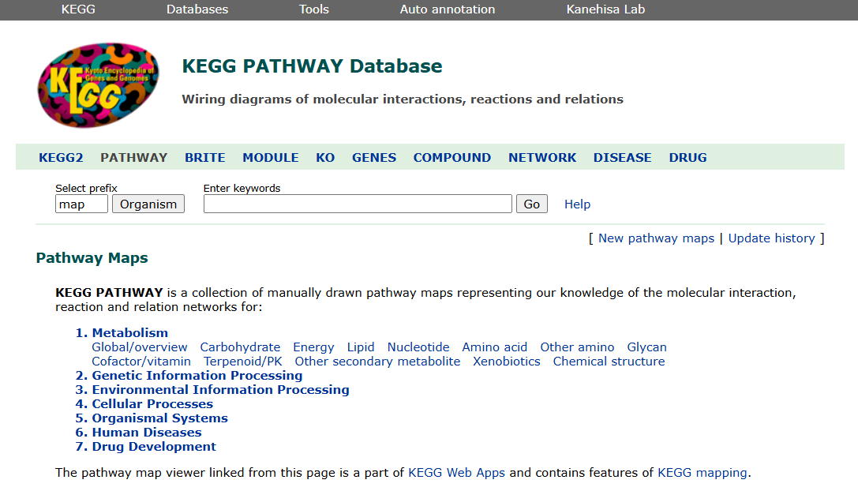

Biological Knowledge Bases
Description: Enhanced databases that include relationships and context
beyond simple data storage, often integrating various types of biological data.
Examples:
KEGG: Pathway and network information
Reactome: Integrates information about molecular interactions, pathways, and reactions
Applications:
Pathway analysis
Functional annotation
Biological interpretation

Slide 62




Biomedical Ontologies
Description: Structured vocabularies that describe categories and relationships in a specific domain
Examples:
Gene Ontology (GO): Terms for gene product attributes
Disease Ontology: Classification of diseases
Applications:
Annotation
Data integration
Semantic search
Natural Language Processing

Slide 63


Ontology Languages
1. OWL (Web Ontology Language)
Standard for creating complex, web-based ontologies
Highly expressive, supports logical rules and reasoning.
Based on Description Logic.
Formats: RDF/XML, OWL/XML, Turtle.
2. OBO (Open Biomedical Ontologies Format)
Simpler format for biomedical ontologies.
Lightweight, easier to read/write.
Focuses on terminologies and basic relationships.
Format: Plain-text.

Slide 64

NCBO - The National Centre for Biomedical Ontology

Slide 65

NCBO

Slide 66

ZOOMA

Slide 67

ZOOMA

Slide 68

Biological Knowledge Graphs
Definition:
Graph-based representation of biological entities and their relationships
Purpose:
Integrate diverse biological data into a unified model for enhanced understanding
Components:
Nodes: Represent biological entities such as genes, proteins, pathways
Edges: Represent relationships or interactions between entities
STRING PPI Network

Slide 69

Biological Knowledge Graphs
Applications:
Disease Research: identifies connections between genes, proteins and diseases.
Drug Discovery: Facilitates target identification and drug repurposing by linking drug targets with biological pathways.
Personalized Medicine: Helps in understanding patient-specific biological profile and predicting treatment outcomes.

Slide 70

Building Knowledge Graphs
Graph Construction
Data Collection
Data Processing and Integration
Storage

Slide 71
Practical: Access Biomedical Resources

